Slide 1
Optimizing and Protecting Gradients in Federated Learning for Privacy, Efficiency, and Personalization
①
②
③
Adding noise to gradients
Redirect gradient updates
Gradient-related Subspace
⑤
④
Layer-wise based personalized model aggregation
Gradients conflicts problem
CPS Computational Learning Laboratory

Slide 2

Paper 1
Balancing Privacy and Accuracy Using Significant Gradient Protection
in Federated Learning
Benteng Zhang , Yingchi Mao , Xiaoming He , Huawei Huang , and Jie Wu
Published in: IEEE TRANSACTIONS ON COMPUTERS
Published Time: 2025
CPS Computational Learning Laboratory

Slide 3
01
Problem Description
02
Method Design
03
Experiment Results
Contents
04
Conclusion
CPS Computational Learning Laboratory

Slide 4
01
Problem Description
02
Method Design
03
Experiment Results
Contents
04
Conclusion
CPS Computational Learning Laboratory

Slide 5
Problem Description
Privacy Risks in Federated Learning :
Federated Learning (FL) allows multiple parties to collaboratively train machine learning models without sharing raw data, thus aiming to protect user privacy.
However, adversaries can infer sensitive user data through membership inference attacks (MIAs), posing a significant privacy risk.
Challenges with Differential Privacy in FL :
Introducing differential privacy (DP) into FL by adding noise to gradients is an effective way to enhance privacy.
Nevertheless, excessive noise introduced during training, especially under low privacy budgets, can lead to sparse local gradients, significantly degrading the accuracy of the global model.
CPS Computational Learning Laboratory

Slide 6
01
Problem Description
02
Method Design
03
Experiment Results
Contents
04
Conclusion
CPS Computational Learning Laboratory

Slide 7
Method Design
FL can protect users’ privacy by enabling multiple parties to train machine learning models without sharing raw data. However, as illustrated in Challenge 1 in Fig. 1, Hu demonstrated a persistent risk of privacy breaches
in training data, due to the fact that external adversaries can infer sensitive user data characteristics by Membership Infer-ence Attacks (MIAs). Differentially Private Federated Learning (DP-FL) introduces controlled random noise into the gradient before uploading to address this issue.
Moreover, as depicted in Challenge 2 in Fig. 1, in DP-FL, excessive noise added to the gradient can lead to a significant degradation in the global model accuracy.
Additionally, in DP-FL, local gradients become excessively sparse in certain training rounds. Especially when training with low privacy budgets, gradient sparsification can give rise to an abundance of noise in the uploaded gradients. This will also lead to a decrease in global model accuracy.
Motivated by these aforementioned issues, we aim to improve the model accuracy and availability while ensuring privacy protection by balancing privacy and accuracy of DP-FL
Significant gradients typically contain highly sensitive information about model parameters. Choosing to protect significant gradients instead of all model parameters can reduce privacy-related overhead and the influence of noise on model accuracy.
CPS Computational Learning Laboratory

Slide 8
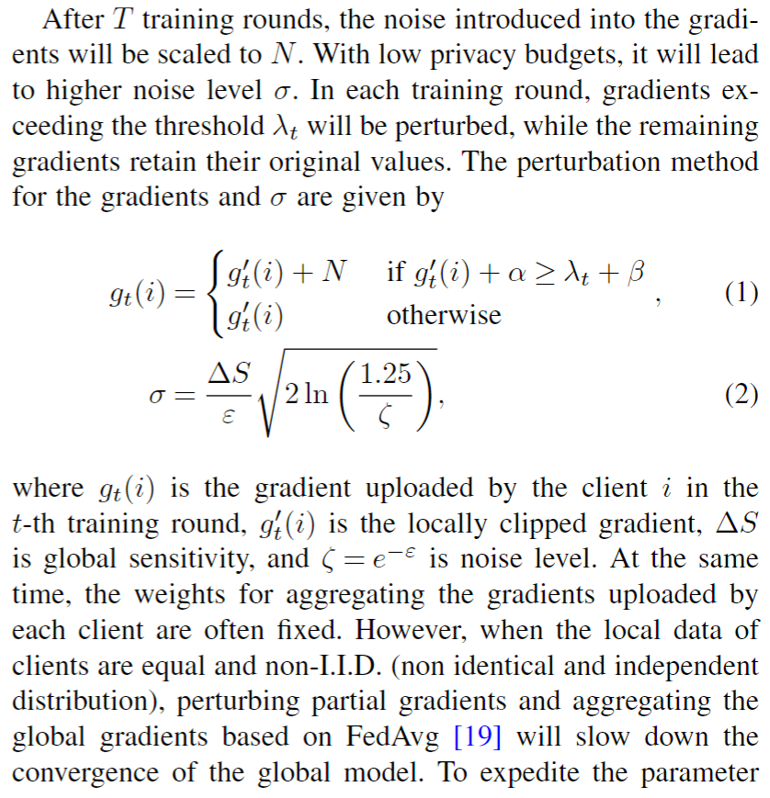
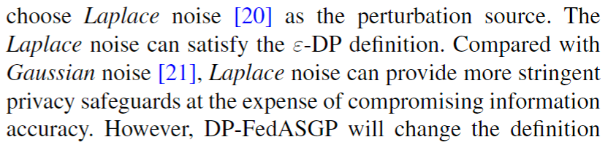
Method Design
Laplace Noise addition
CPS Computational Learning Laboratory

Slide 9
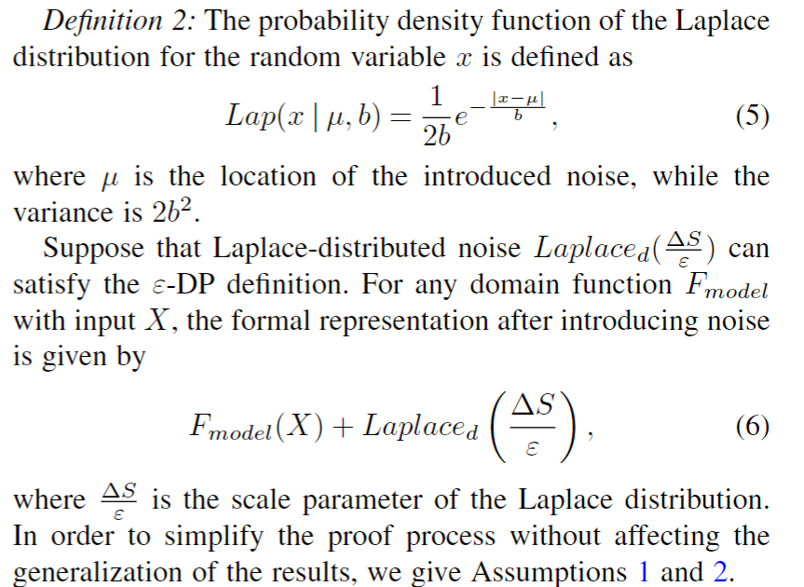
Method Design
Laplace Noise definition
CPS Computational Learning Laboratory

Slide 10
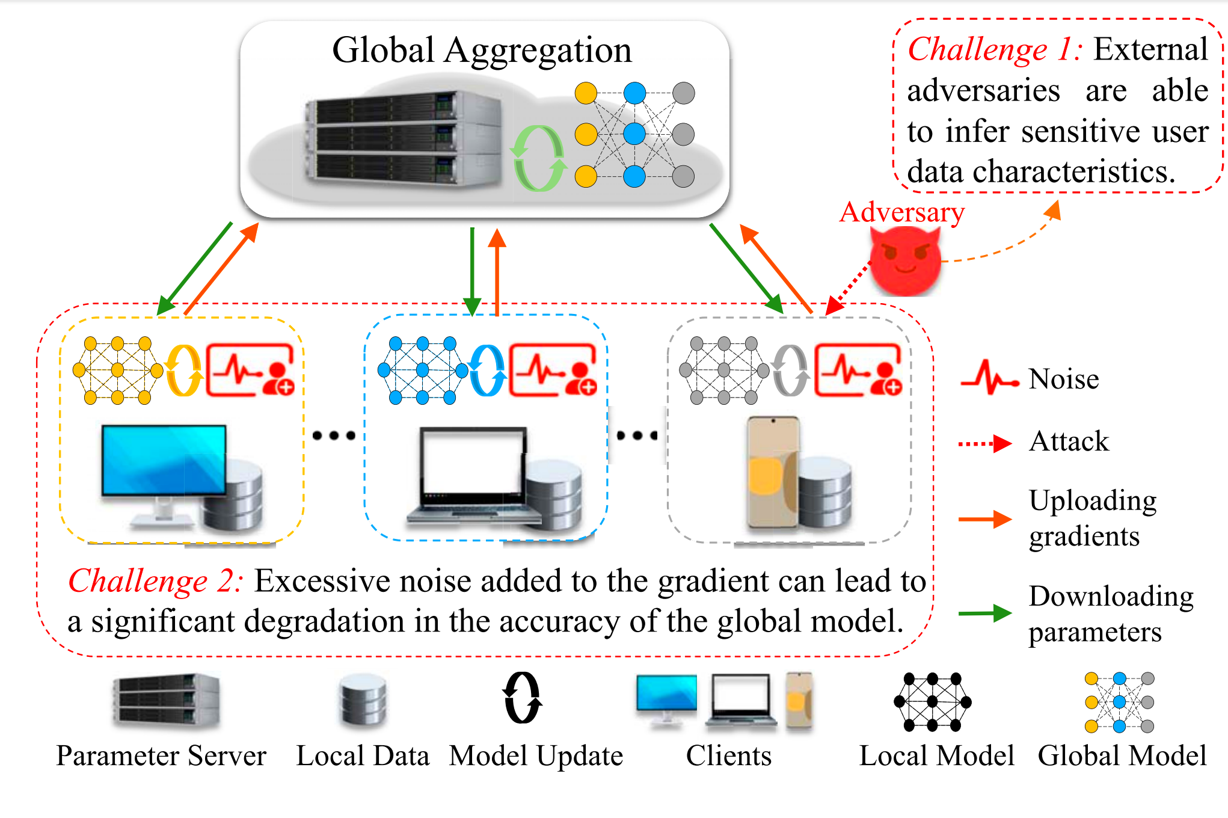
Method Design
CPS Computational Learning Laboratory

Slide 11
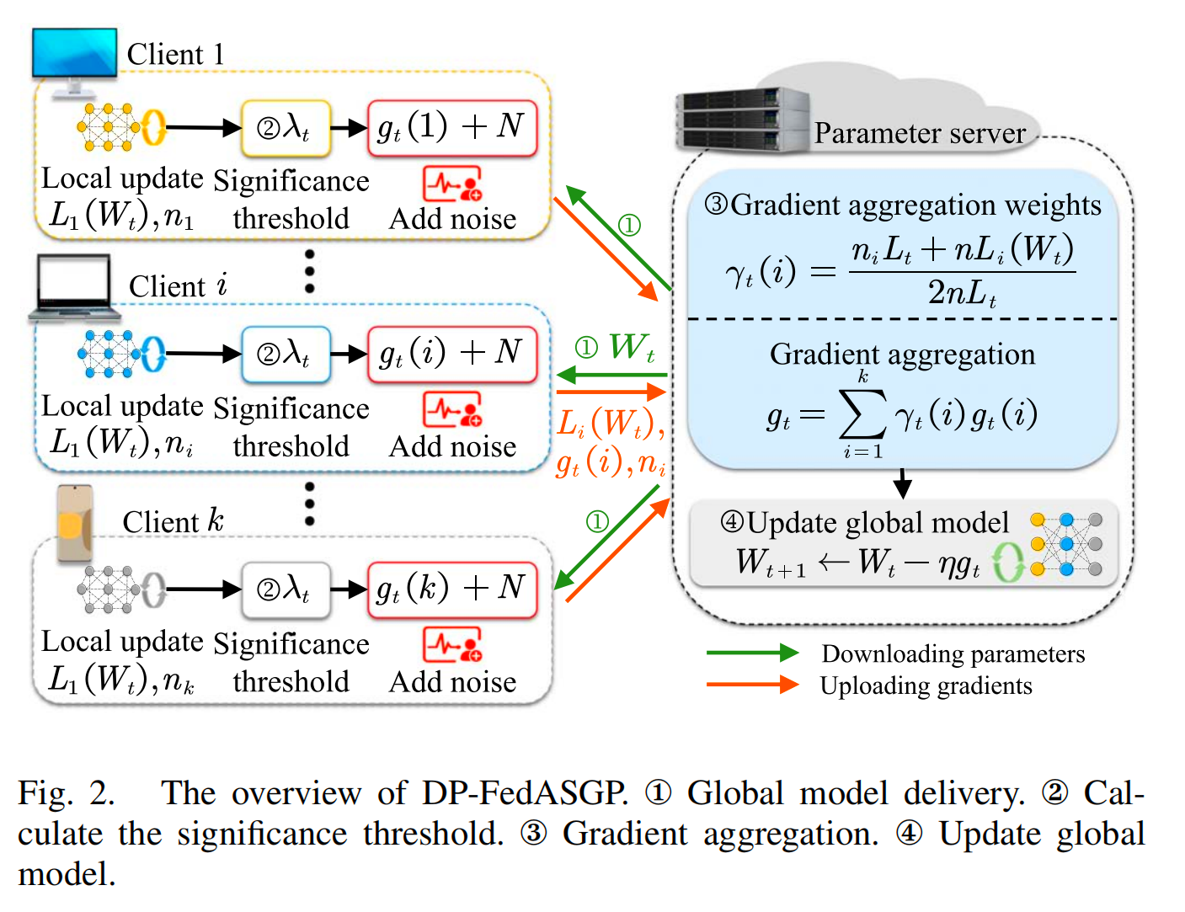
Method Design
CPS Computational Learning Laboratory

Slide 12
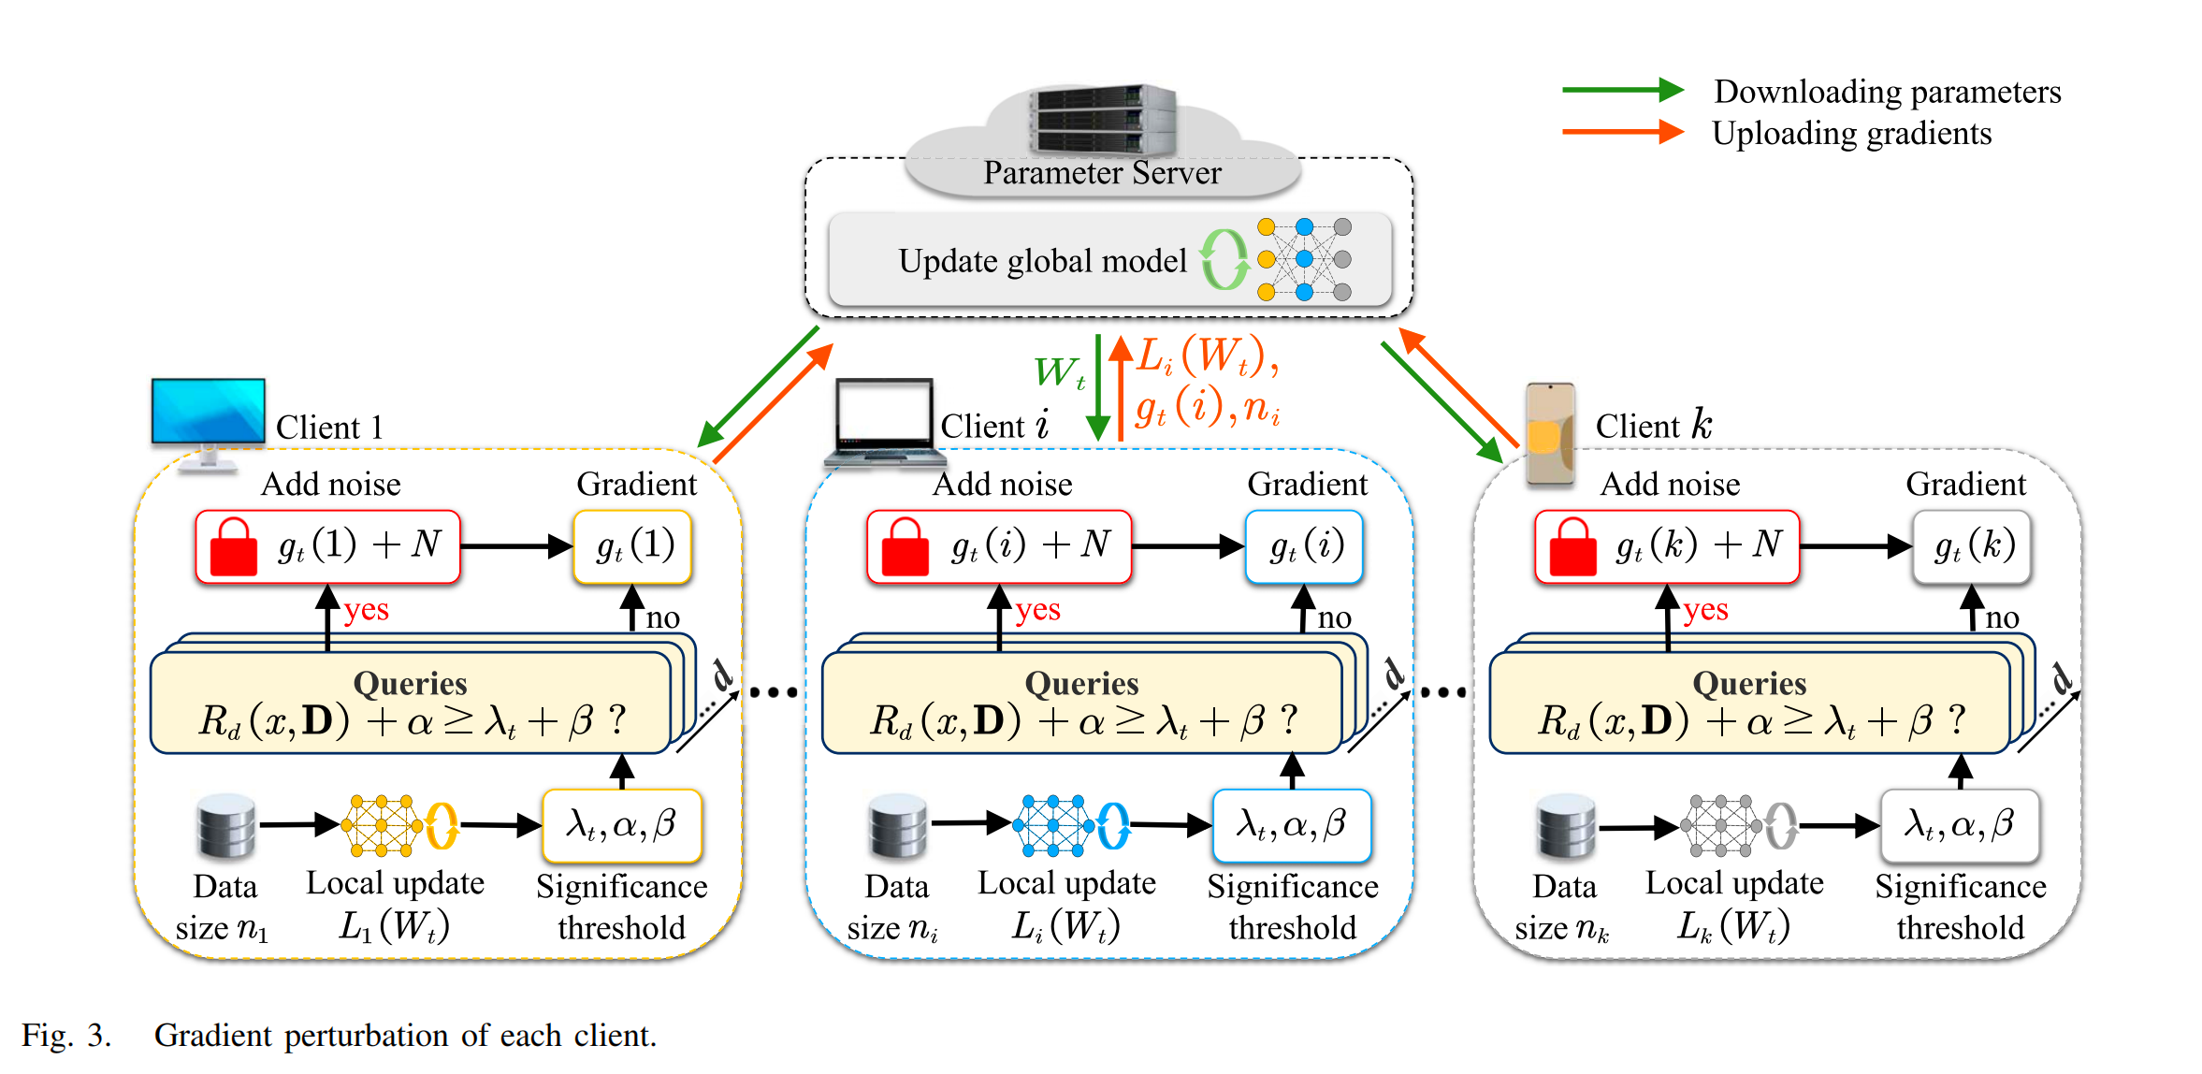
Method Design
CPS Computational Learning Laboratory

Slide 13
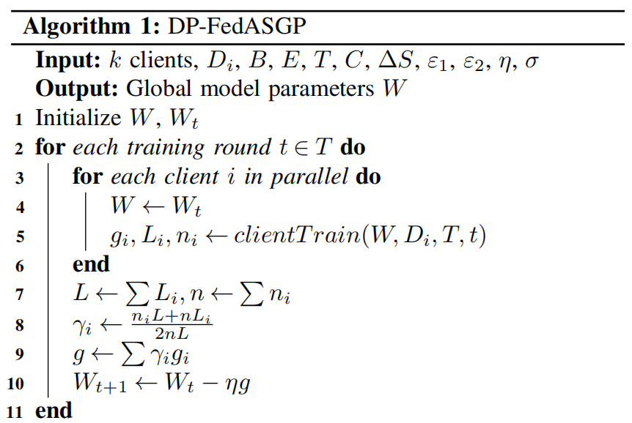
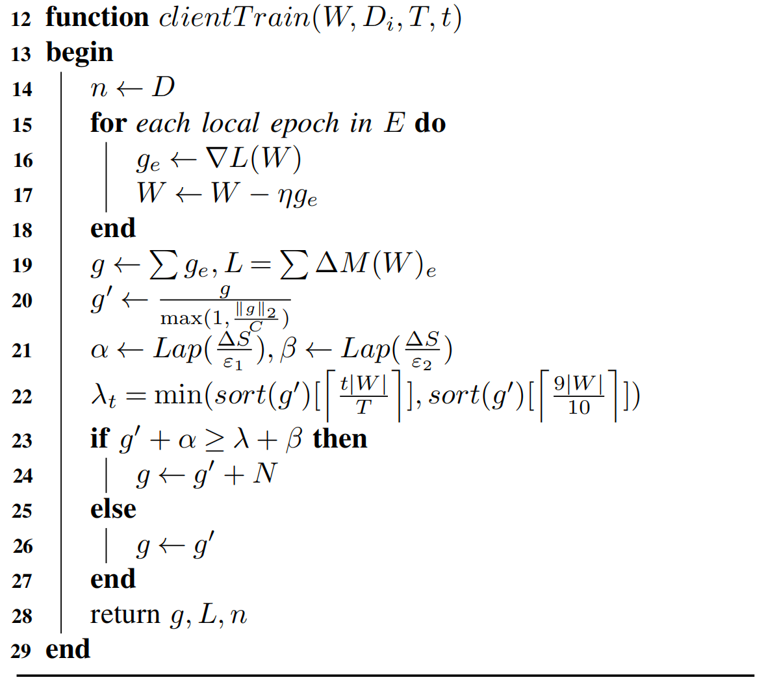
Method Design
Gradient Clipping
Dynamic Gradient Aggregation
Significant Gradient Selection
CPS Computational Learning Laboratory

Slide 14
01
Problem Description
02
Method Design
03
Experiment Results
Contents
04
Conclusion
CPS Computational Learning Laboratory

Slide 15
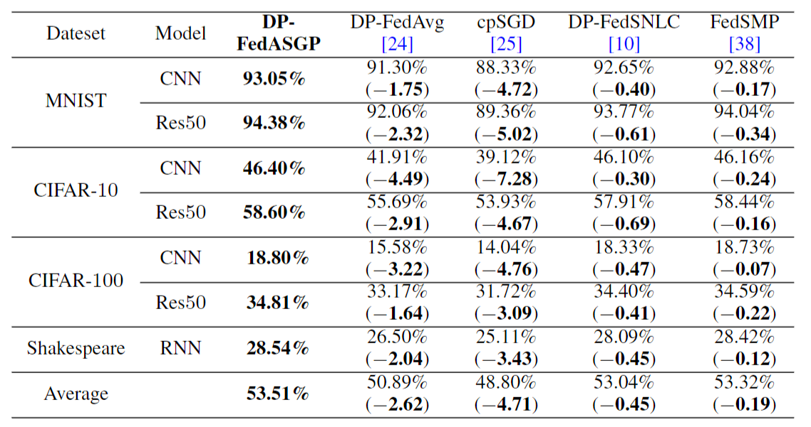
Experiment Results
CPS Computational Learning Laboratory

Slide 16
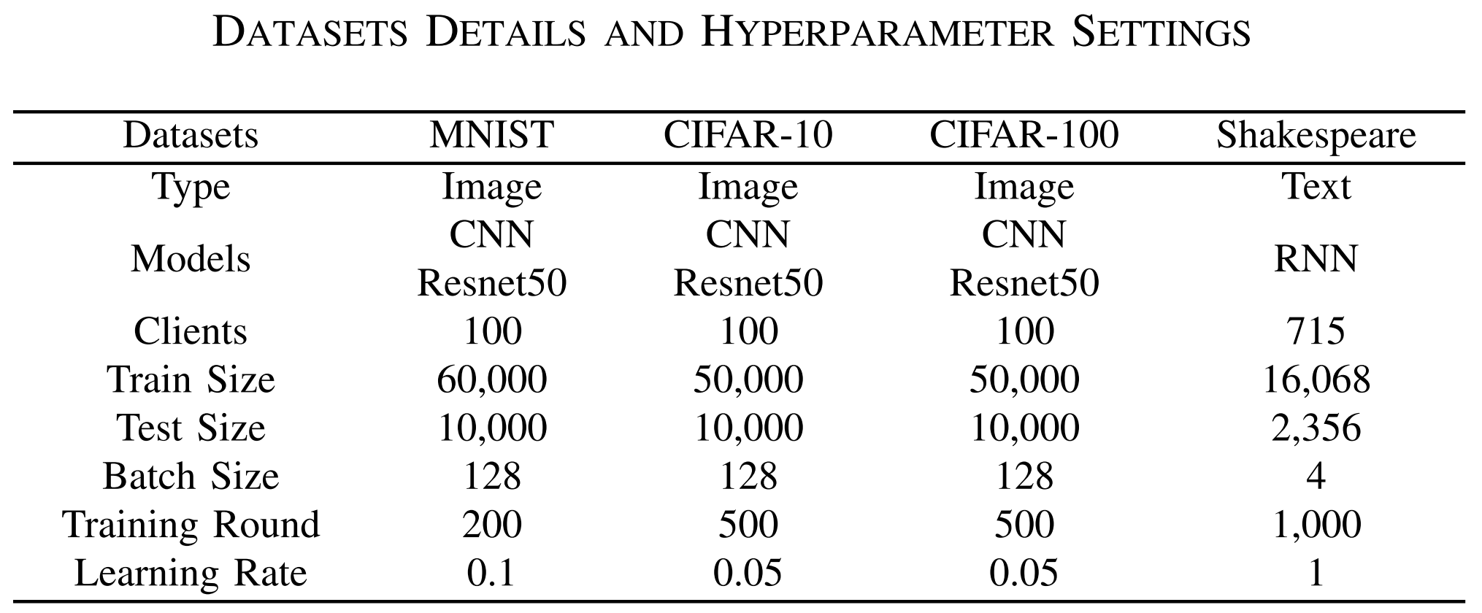
Experiment Results
CPS Computational Learning Laboratory

Slide 17
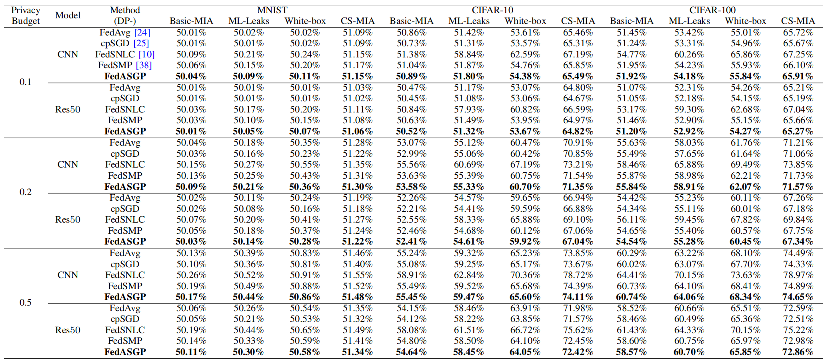
Experiment Results
CPS Computational Learning Laboratory

Slide 18
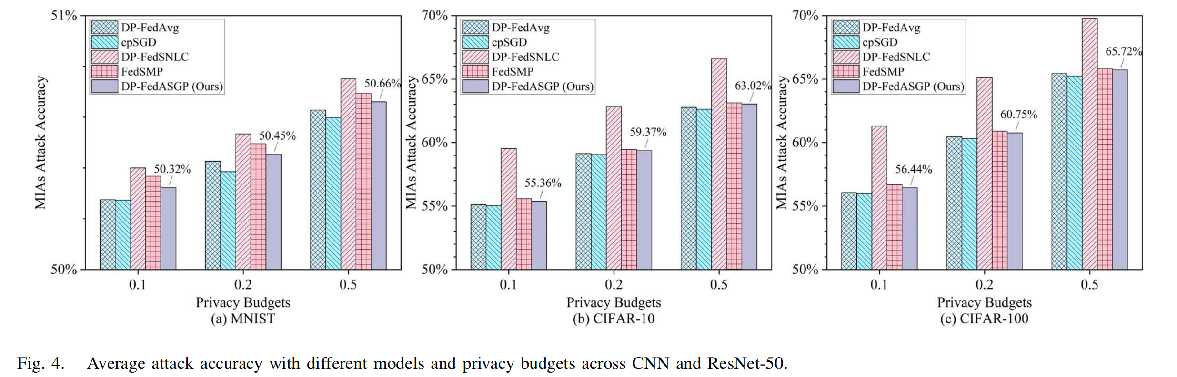
Experiment Results
CPS Computational Learning Laboratory

Slide 19
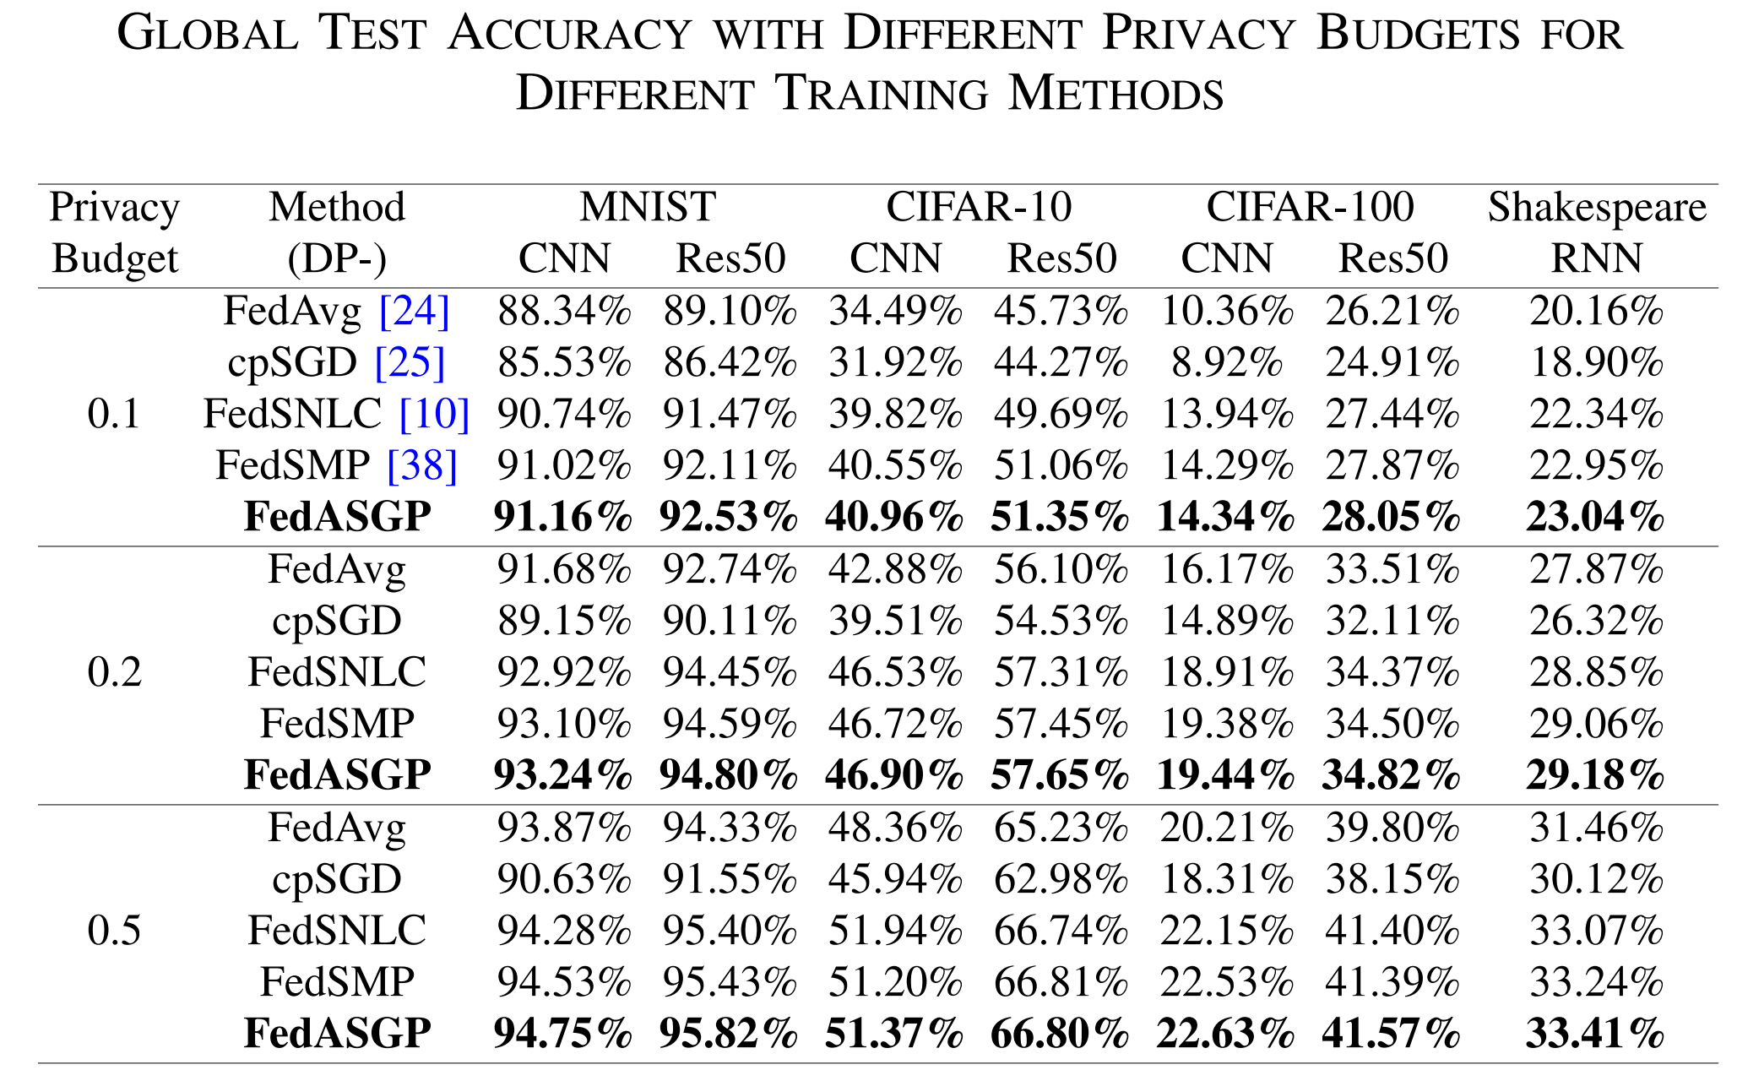
Experiment Results
CPS Computational Learning Laboratory

Slide 20
01
Problem Description
02
Method Design
03
Experiment Results
Contents
04
Conclusion
CPS Computational Learning Laboratory
CPS Computational Learning Laboratory
2
18

Slide 21
Conclusion
Local gradients of DP-FL become excessively sparse in certain training rounds. Especially when training with low privacy budgets, there is a risk of introducing excessive noise into the uploaded gradients. This issue leads to a significant degradation in the accuracy of the global model.
To effectively balance the privacy protection and model accuracy of DP-FL, we propose an approach called DP-FedASGP, which combines the idea of gradient sparsification and DP to achieve both gradient perturbation and gradient aggregation in DP-FL.
Particularly, DPFedASGP constructs a gradient perturbation method based on sparse vectors to evaluate and protect significant gradients in each training round.
Subsequently, to dynamically calculate the aggregation weights of the gradients, DP-FedASGP employs a dynamic aggregation weights calculation method based on the local loss function and the local data size.
Enlightenment：By protecting important gradients and adding carefully computed noise to the gradients, it is possible to protect against external perturbation
CPS Computational Learning Laboratory

Slide 22
Paper 2
CGoFed: Constrained Gradient Optimization
Strategy for Federated Class Incremental Learning
Jiyuan Feng , Xu Yang , Liwen Liang, Weihong Han, Binxing Fang, and Qing Liao
Publish Journal: IEEE TRANSACTIONS ON KNOWLEDGE AND DATA ENGINEERING
Published Time: 2025
CPS Computational Learning Laboratory

Slide 23
01
Problem Description
02
Method Design
03
Experiment Results
Contents
04
Conclusion
CPS Computational Learning Laboratory

Slide 24
01
Problem Description
02
Method Design
03
Experiment Results
Contents
04
Conclusion
CPS Computational Learning Laboratory

Slide 25
Problem Description
Federated class incremental learning (FCIL)
Federated learning (FL) commonly assumes that clients maintain a static label distribution of local data during the training and testing phases of the model. However, in the real world, the label distributions of clients often change dynamically over time, and each local client continuously introduces new classes to update the knowledge of the global model. This scenario, known as federated class incremental learning (FCIL), also referred to as federated continuous learning or lifelong federated learning, reflects a more natural and realistic setting.
Given that clients in federated learning are typically light weight mobile devices with limited storage capacity, constantly storing new data can lead to a significant memory crisis. If clients only store and train the model on the new class, this can result in catastrophic forgetting of the old class, as the model may struggle to distinguish between the old class and the new data.
CPS Computational Learning Laboratory

Slide 26
01
Problem Description
02
Method Design
03
Experiment Results
Contents
04
Conclusion
CPS Computational Learning Laboratory

Slide 27
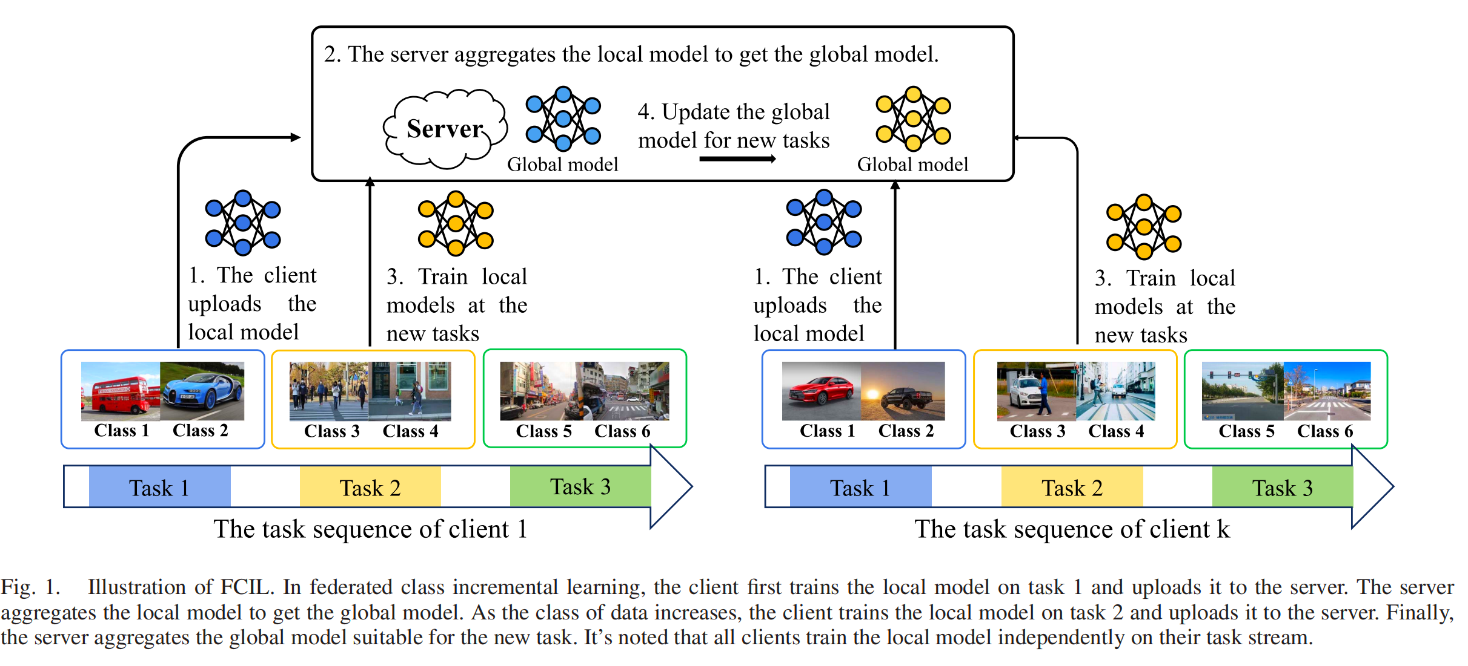
Method Design
CPS Computational Learning Laboratory

Slide 28
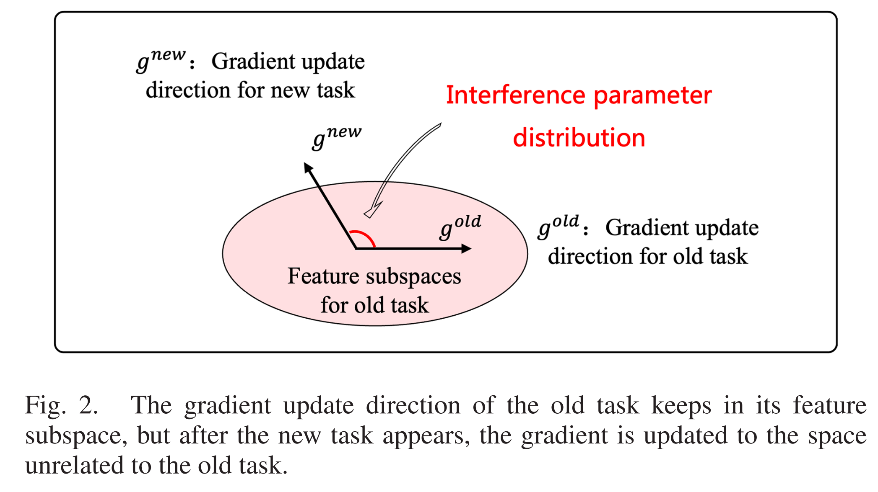
Method Design
CPS Computational Learning Laboratory

Slide 29
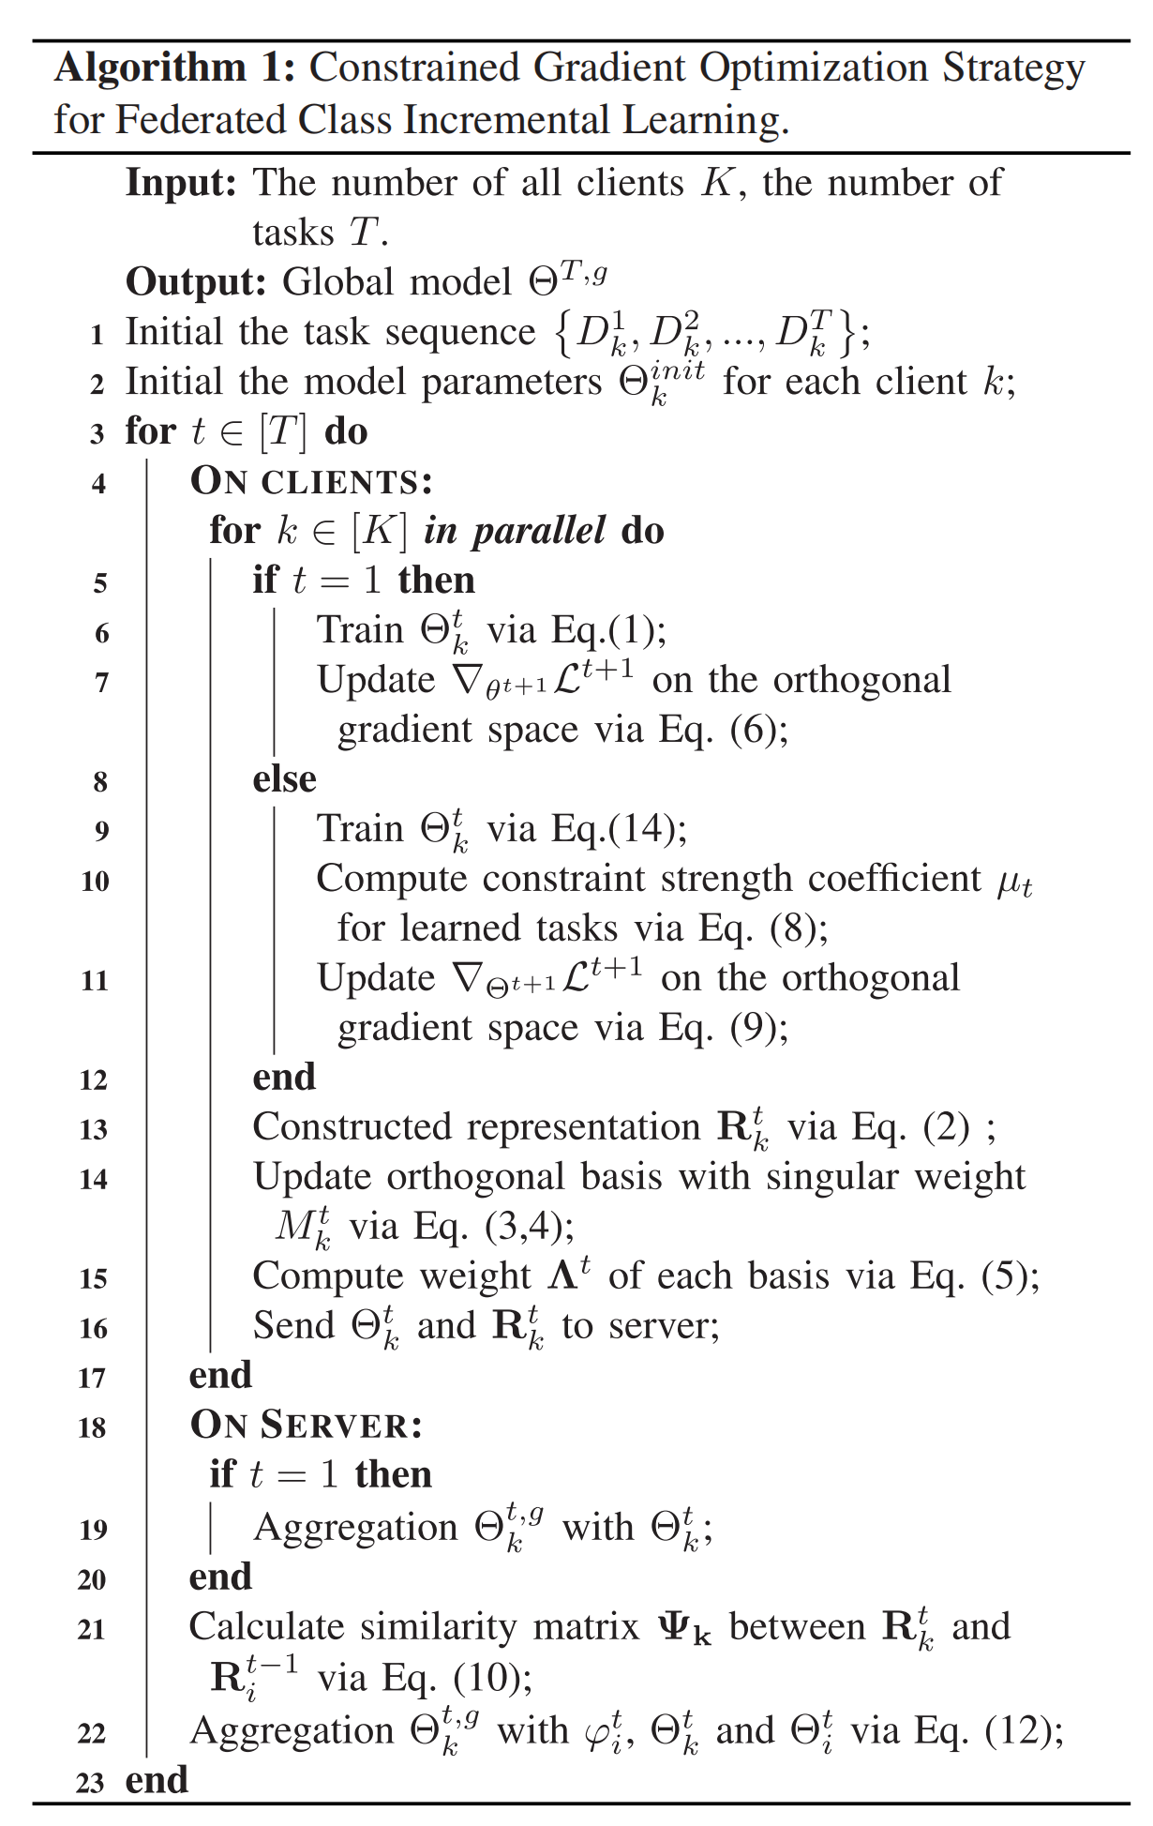
Method Design
CPS Computational Learning Laboratory

Slide 30
Method Design
Constrained Gradient Optimization Strategy for Federated Class Incremental Learning
Relax-Constrained Gradient Update：Improve adaptability to new tasks while maintaining historical task knowledge by flexibly redirecting gradient updates
Cross-Task Gradient Regularization：The performance degradation due to non-identical label distribution is mitigated by using historical model information from other clients to find the most relevant task to the current task.
CPS Computational Learning Laboratory

Slide 31
Method Design
Mitigating Catastrophic Forgetting
By introducing the Relax-Constrained Gradient Update module, we can effectively limit the interference of new tasks with the historical tasks, and thus reduce the forgetting of knowledge of old tasks when learning new tasks.
CGoFed dynamically adjusts the gradient update direction during training so that it is not completely orthogonal to the gradient space of the historical tasks, but allows a certain degree of flexibility (achieved by constraining the intensity factor μ and the threshold τ ).
Experimental results show that CGoFed significantly reduces the Average Forgetting (AF) rate on multiple datasets and still maintains a high historical task accuracy in later tasks.
CPS Computational Learning Laboratory

Slide 32
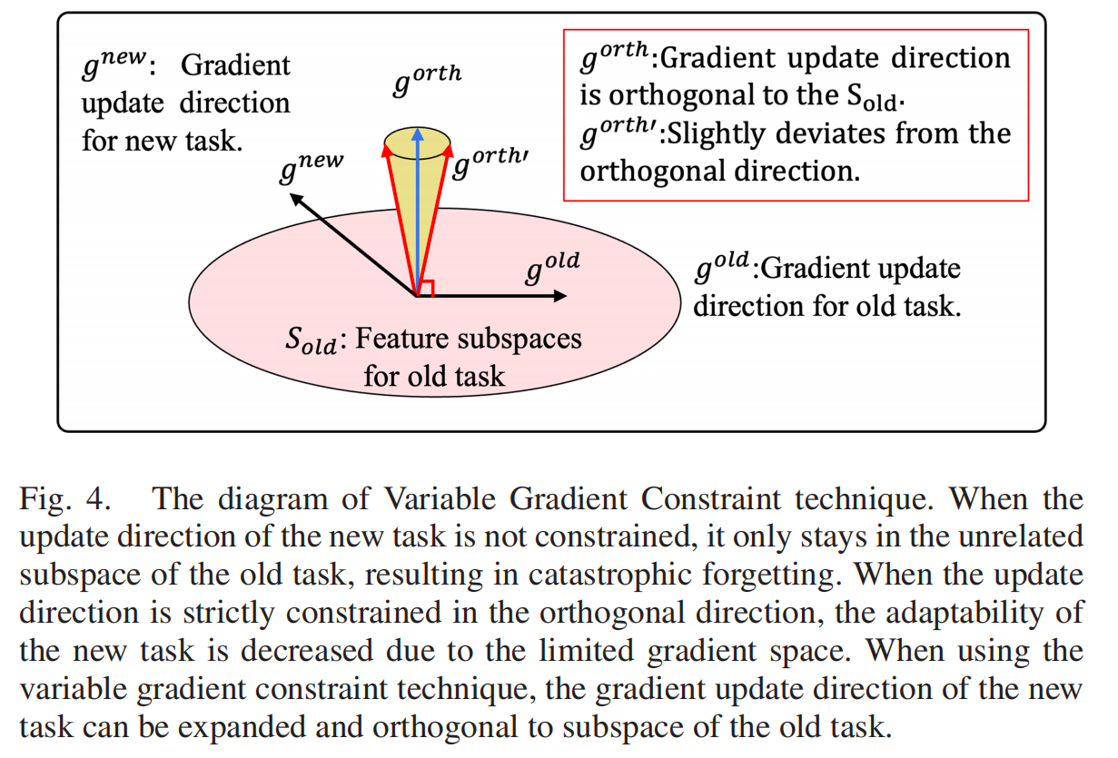
Method Design
Variable Gradient Constraint technique
CPS Computational Learning Laboratory

Slide 33
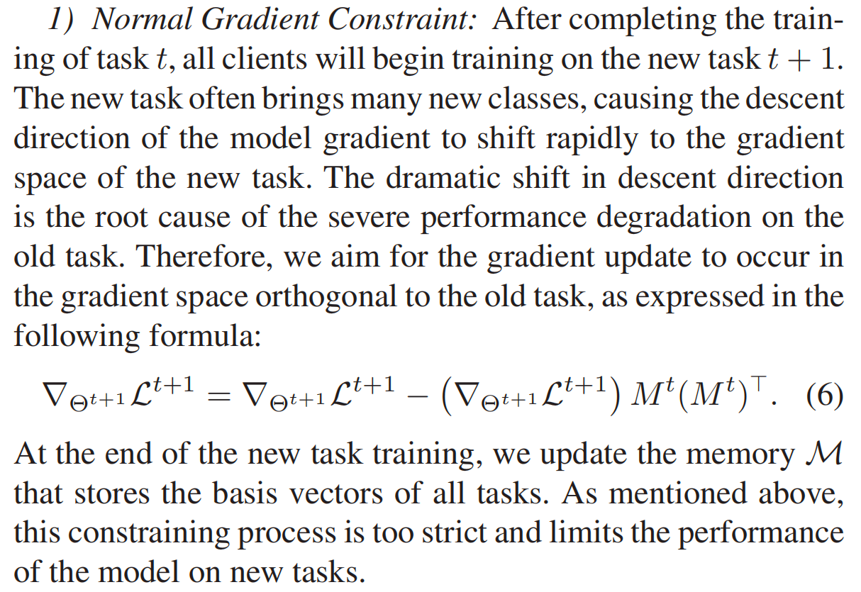
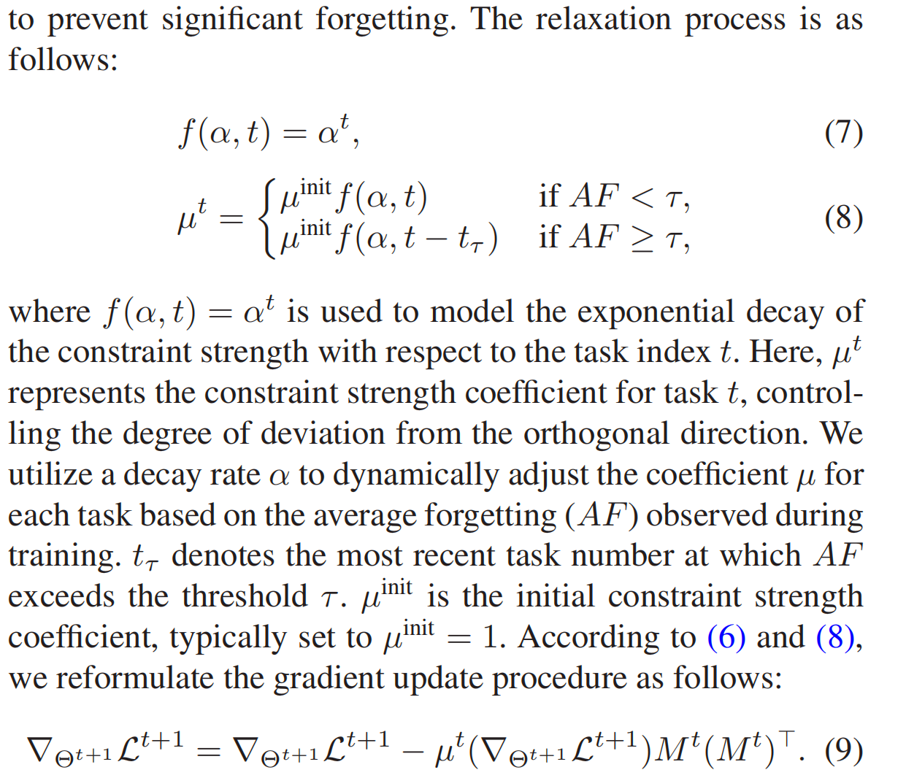
Method Design
Relax-Constrainted Gradient Update
CPS Computational Learning Laboratory

Slide 34
Method Design
Cross-Task Gradient Regularization
we propose a cross-task gradient regularization module of CGoFed to solve the problem of non-identical label distribution for incremental data between the clients in federated class incremental learning.
Each client’s task streams are independent, leading to unique class distributions in incremental data at each time step. This independence poses a challenge for server aggregation, as local models may interfere with each other. It is intuitive that the current task of client i may overlap with historical tasks of another client j. Therefore, leveraging valuable knowledge from historical models of other clients can mitigate catastrophic forgetting and improve the global model’s performance on the current task.
CPS Computational Learning Laboratory

Slide 35
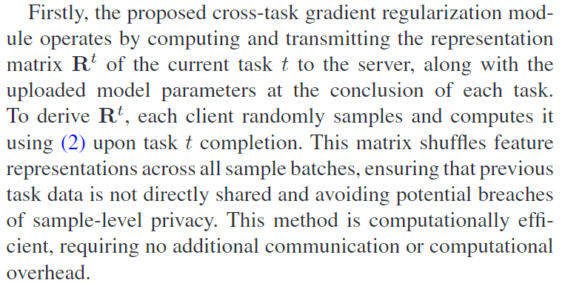
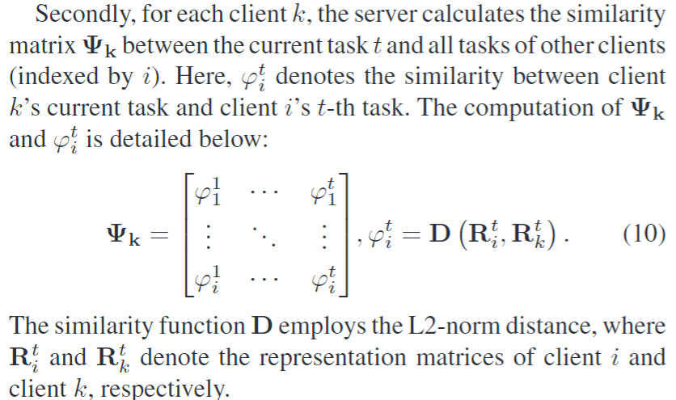
Method Design
Cross-Task Gradient Regularization
CPS Computational Learning Laboratory

Slide 36
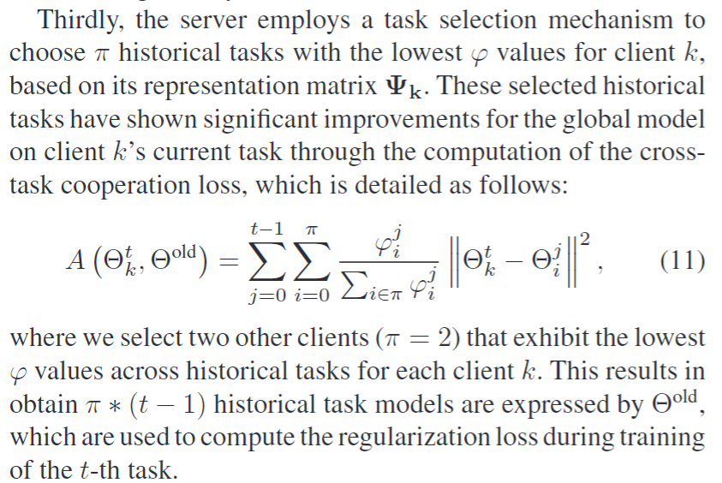
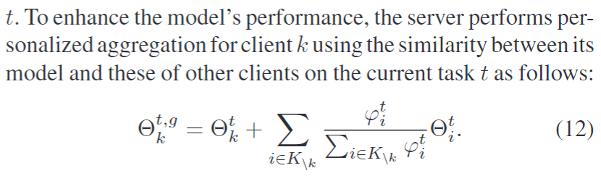
Method Design
CPS Computational Learning Laboratory

Slide 37
01
Problem Description
02
Method Design
03
Experiment Results
Contents
04
Conclusion
CPS Computational Learning Laboratory

Slide 38
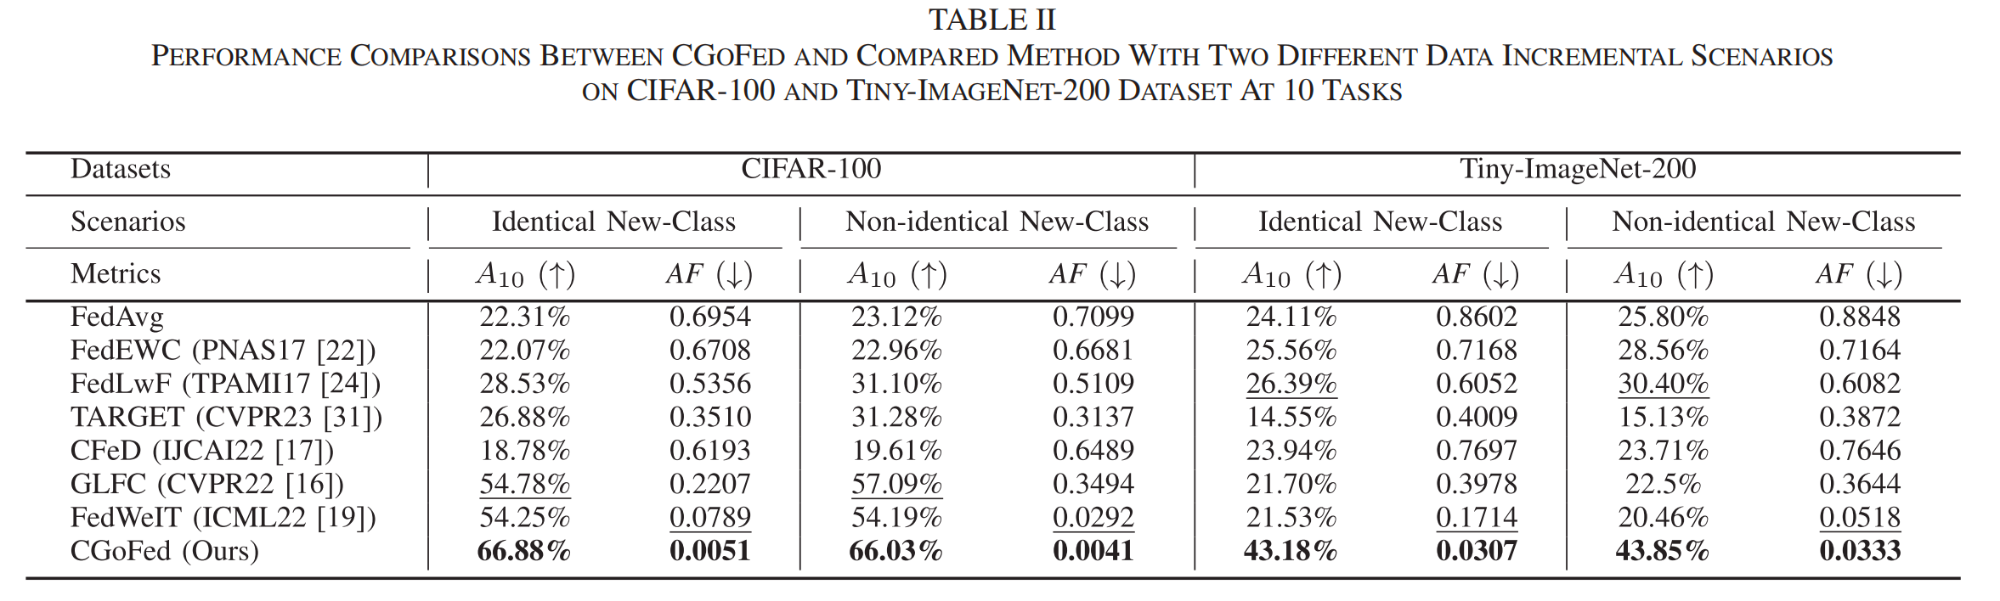
Method Design
CPS Computational Learning Laboratory

Slide 39
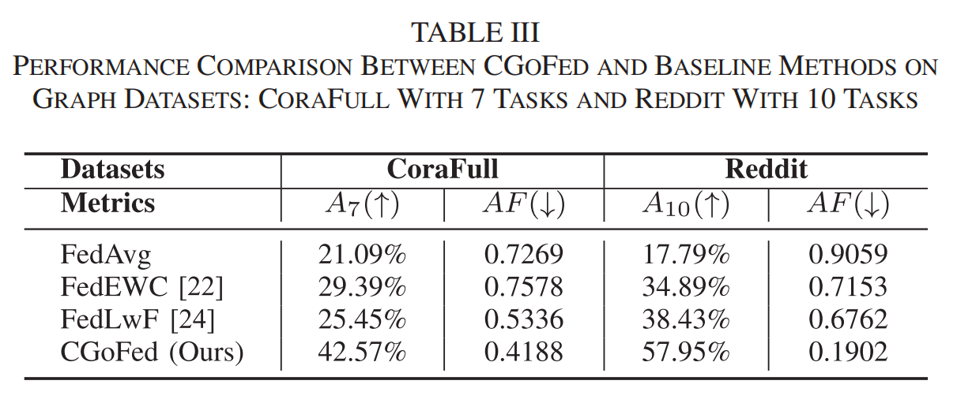
Method Design
CPS Computational Learning Laboratory

Slide 40
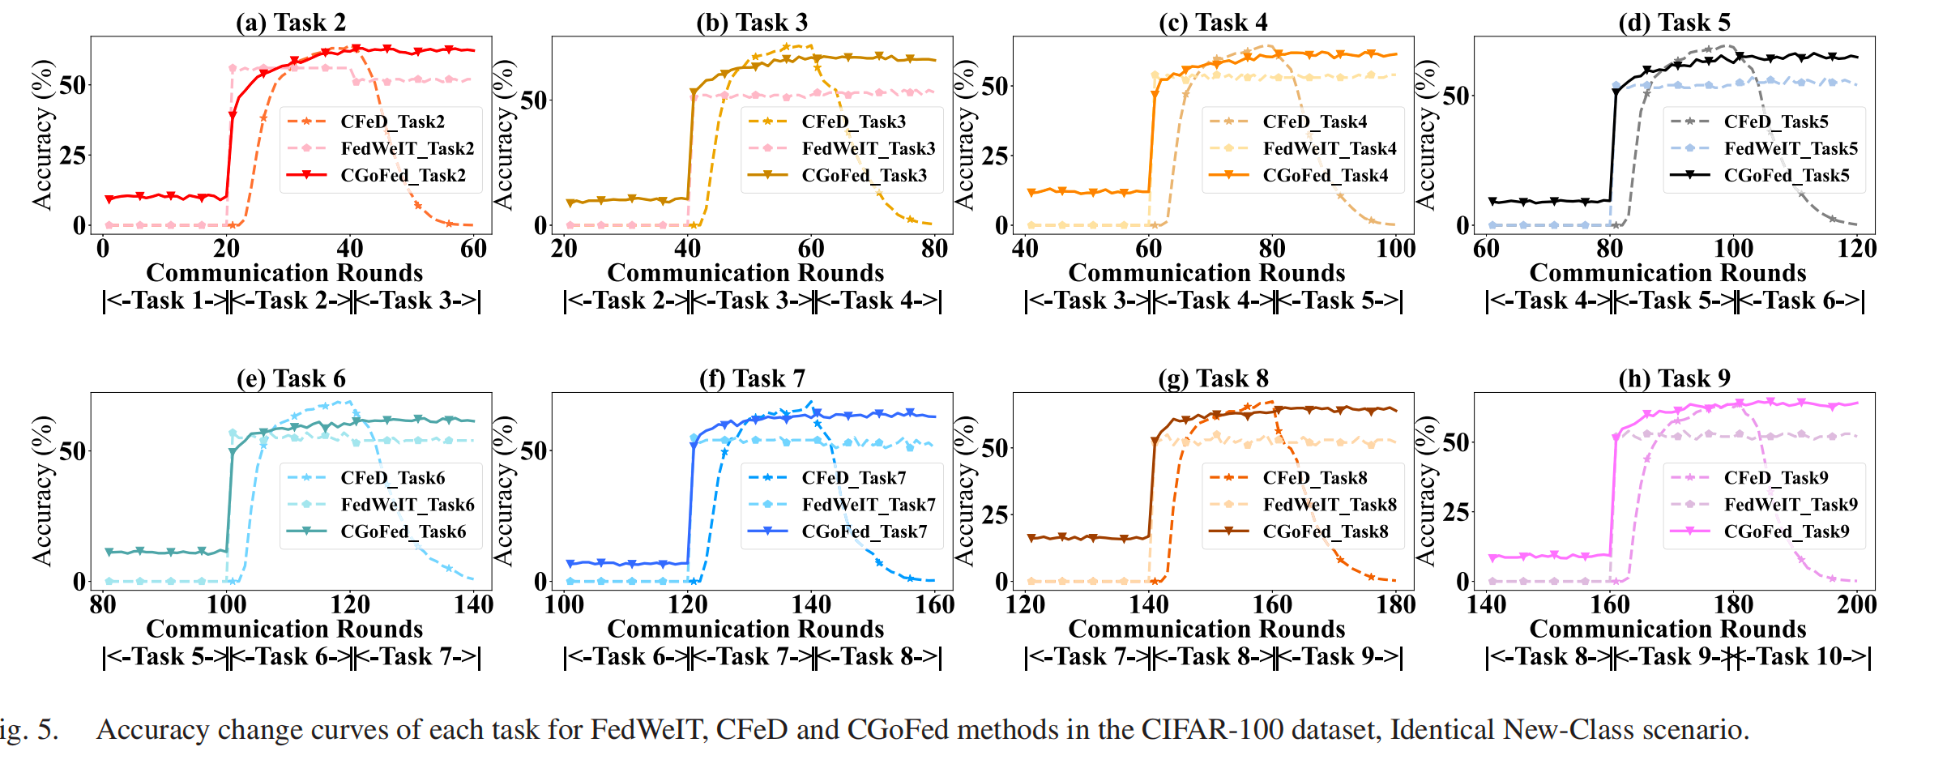
Method Design
CPS Computational Learning Laboratory

Slide 41
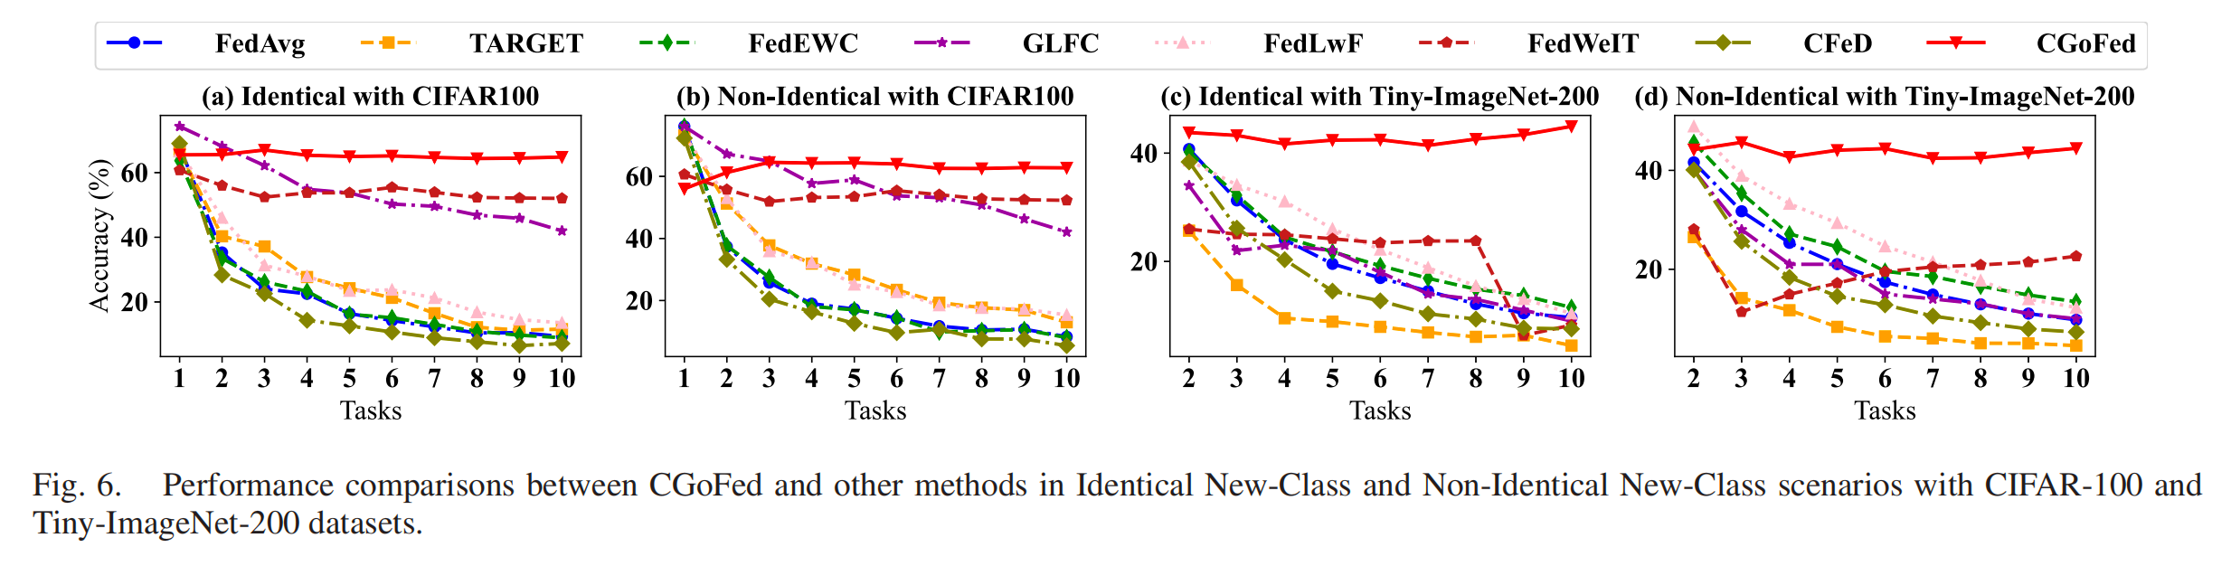
Method Design
CPS Computational Learning Laboratory

Slide 42
01
Problem Description
02
Method Design
03
Experiment Results
Contents
04
Conclusion
CPS Computational Learning Laboratory
CPS Computational Learning Laboratory
2
18

Slide 43
conclusion
In conclusion, this paper presents the CGoFed method to address the trade-off problem between stability and plasticity in federated class incremental learning by focusing on gradient updates. Our method relax-constrained the gradient update direction of the local model to preserve knowledge from previous tasks without revisiting historical task data or relying on auxiliary datasets.
Additionally, we designed a regularization loss to facilitate client cross-task cooperation from the server’s perspective. Extensive experimental results demonstrate the effectiveness of our method compared to existing federated class incremental learning methods.
Enlightenment：By redirecting the gradient update, Federal learning can be continuously adapted to new tasks
CPS Computational Learning Laboratory

Slide 44
Paper 3
Federated Gradient Matching Pursuit
Halyun Jeong , Deanna Needell , Member, IEEE, and Jing Qin , Member, IEEE
Publish Journal:IEEE TRANSACTIONS ON INFORMATION THEORY
Published Time: 2024
CPS Computational Learning Laboratory

Slide 45
01
Problem Description
02
Method Design
03
Experiment Results
Contents
04
Conclusion
CPS Computational Learning Laboratory

Slide 46
01
Problem Description
02
Method Design
03
Experiment Results
Contents
04
Conclusion
CPS Computational Learning Laboratory

Slide 47
Problem Description
The paper addresses the problem of solving sparsity-constrained optimization in Federated Learning (FL), where data is distributed across multiple clients with heterogeneity and privacy concerns. Existing methods face challenges such as high communication costs, sensitivity to learning rates, and inefficiency in handling sparse structures.
The proposed FedGradMP algorithm combines gradient matching pursuit and hard-thresholding to efficiently solve sparse optimization problems in FL settings.
It reduces communication overhead by projecting models onto low-dimensional subspaces, ensures robustness under data heterogeneity, and avoids intensive tuning of learning rates.
The goal is to develop a framework that achieves fast convergence, minimizes residual error, and adapts to practical FL scenarios like partial client participation and general dictionary-based sparsity.
CPS Computational Learning Laboratory

Slide 48
01
Problem Description
02
Method Design
03
Experiment Results
Contents
04
Conclusion
CPS Computational Learning Laboratory

Slide 49
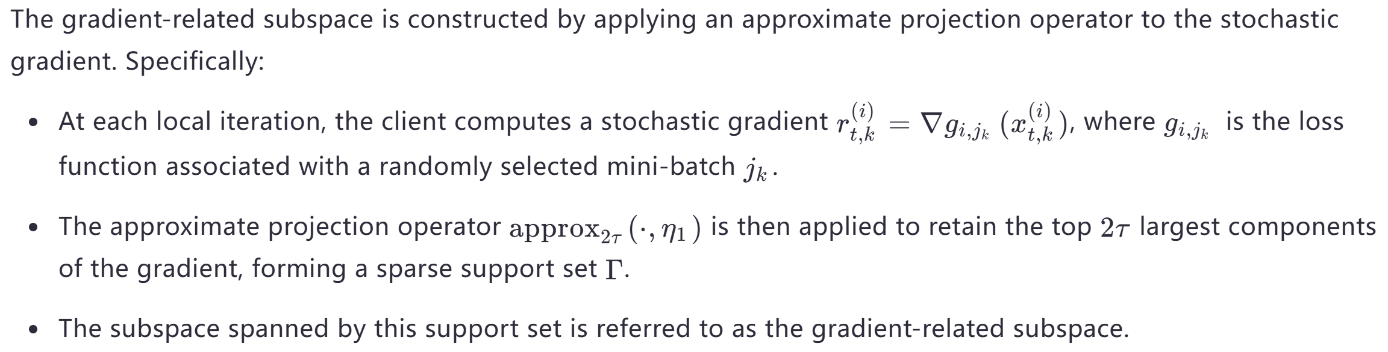
Method Design
Gradient-related Subspace
CPS Computational Learning Laboratory

Slide 50
Method Design
The importance of sparse optimization in federated learning
In many machine learning and signal processing applications, the desired solution naturally has a certain structure that can be framed as sparsity with respect to a certain dictionary. This problem can be formulated as an optimization problem with sparsity constraints, and solving it efficiently has been one of the primary research topics in the traditional centralized setting.
Challenges in Federated Learning
In federated learning, data is distributed across multiple clients, and the goal is to collaboratively solve the optimization problem while minimizing communication costs. Techniques such as sparsifying and reducing the dimensionality of the gradients have been proposed to address this issue.
CPS Computational Learning Laboratory

Slide 51
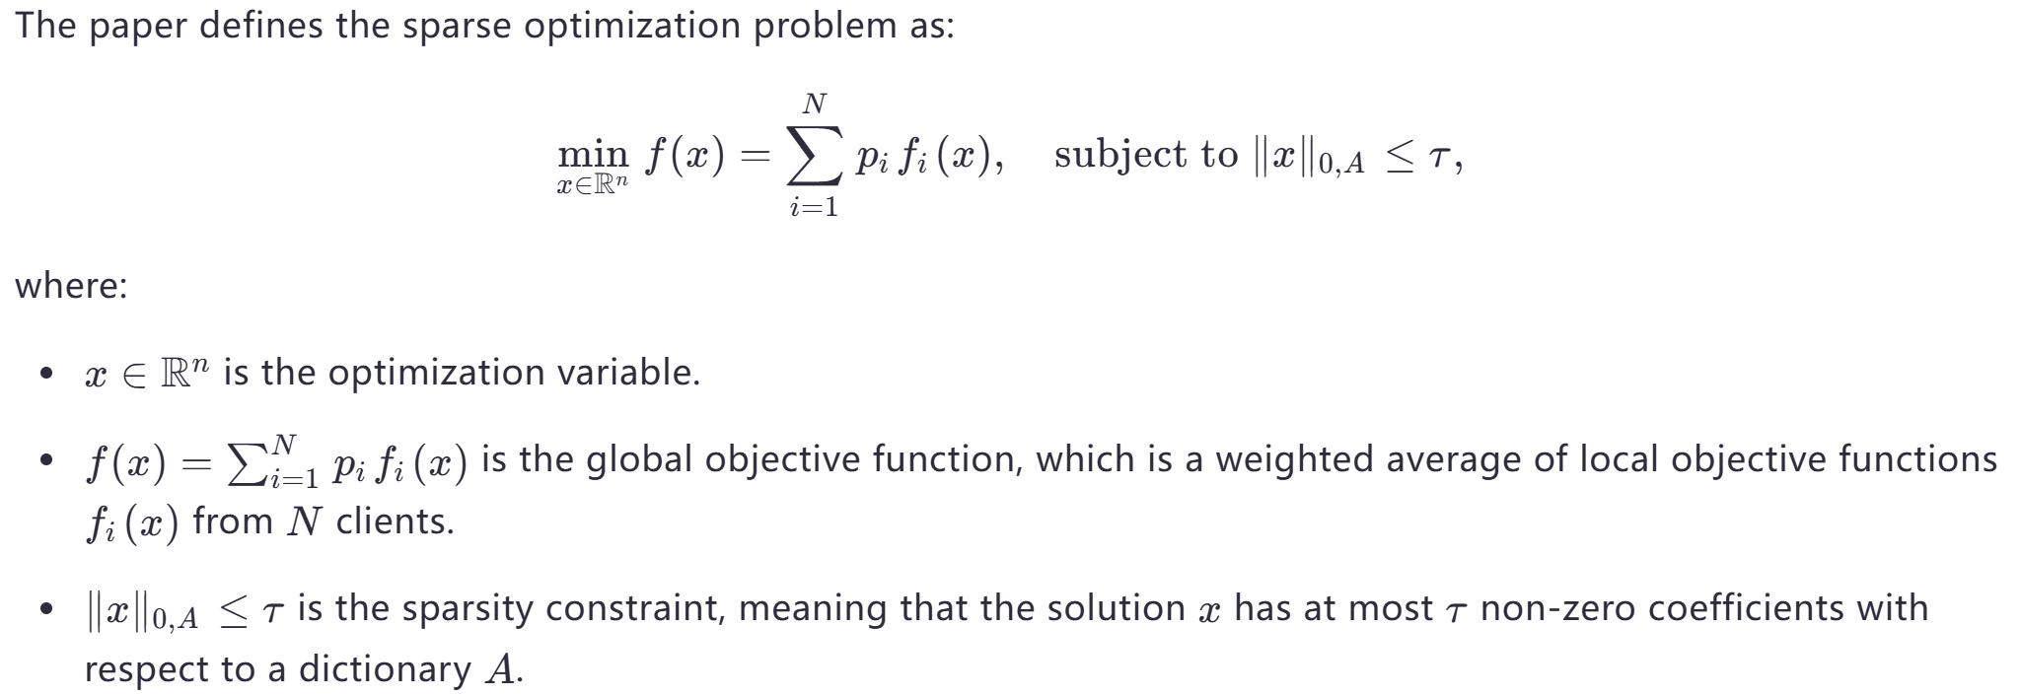
Method Design
Definition of Sparse Optimization
CPS Computational Learning Laboratory

Slide 52
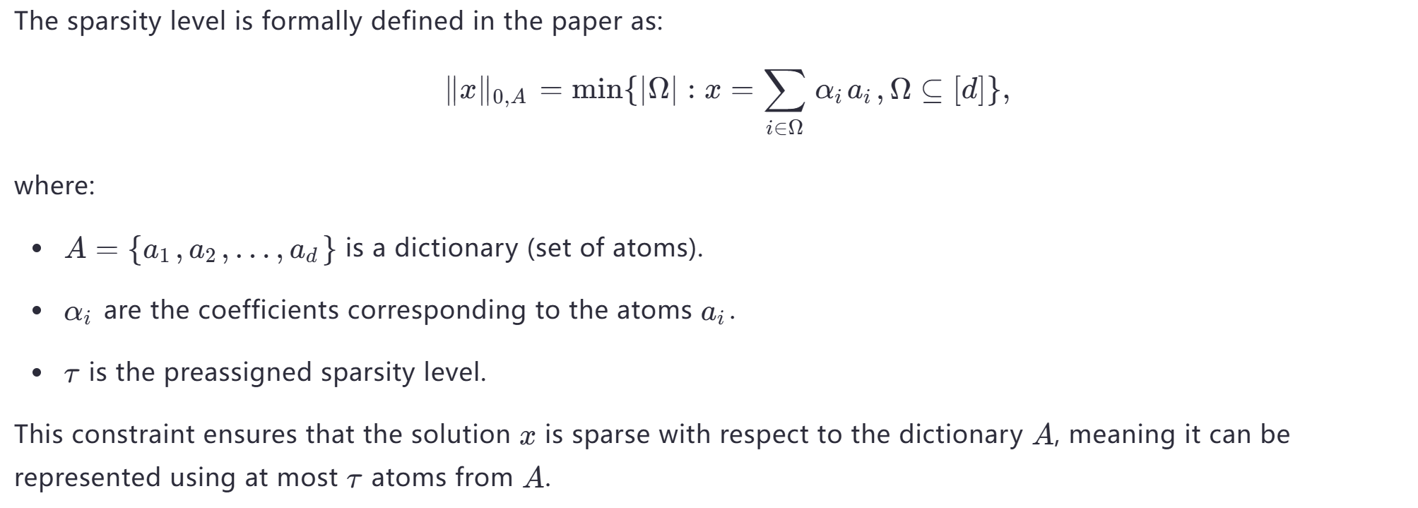
Method Design
Sparsity level
CPS Computational Learning Laboratory

Slide 53
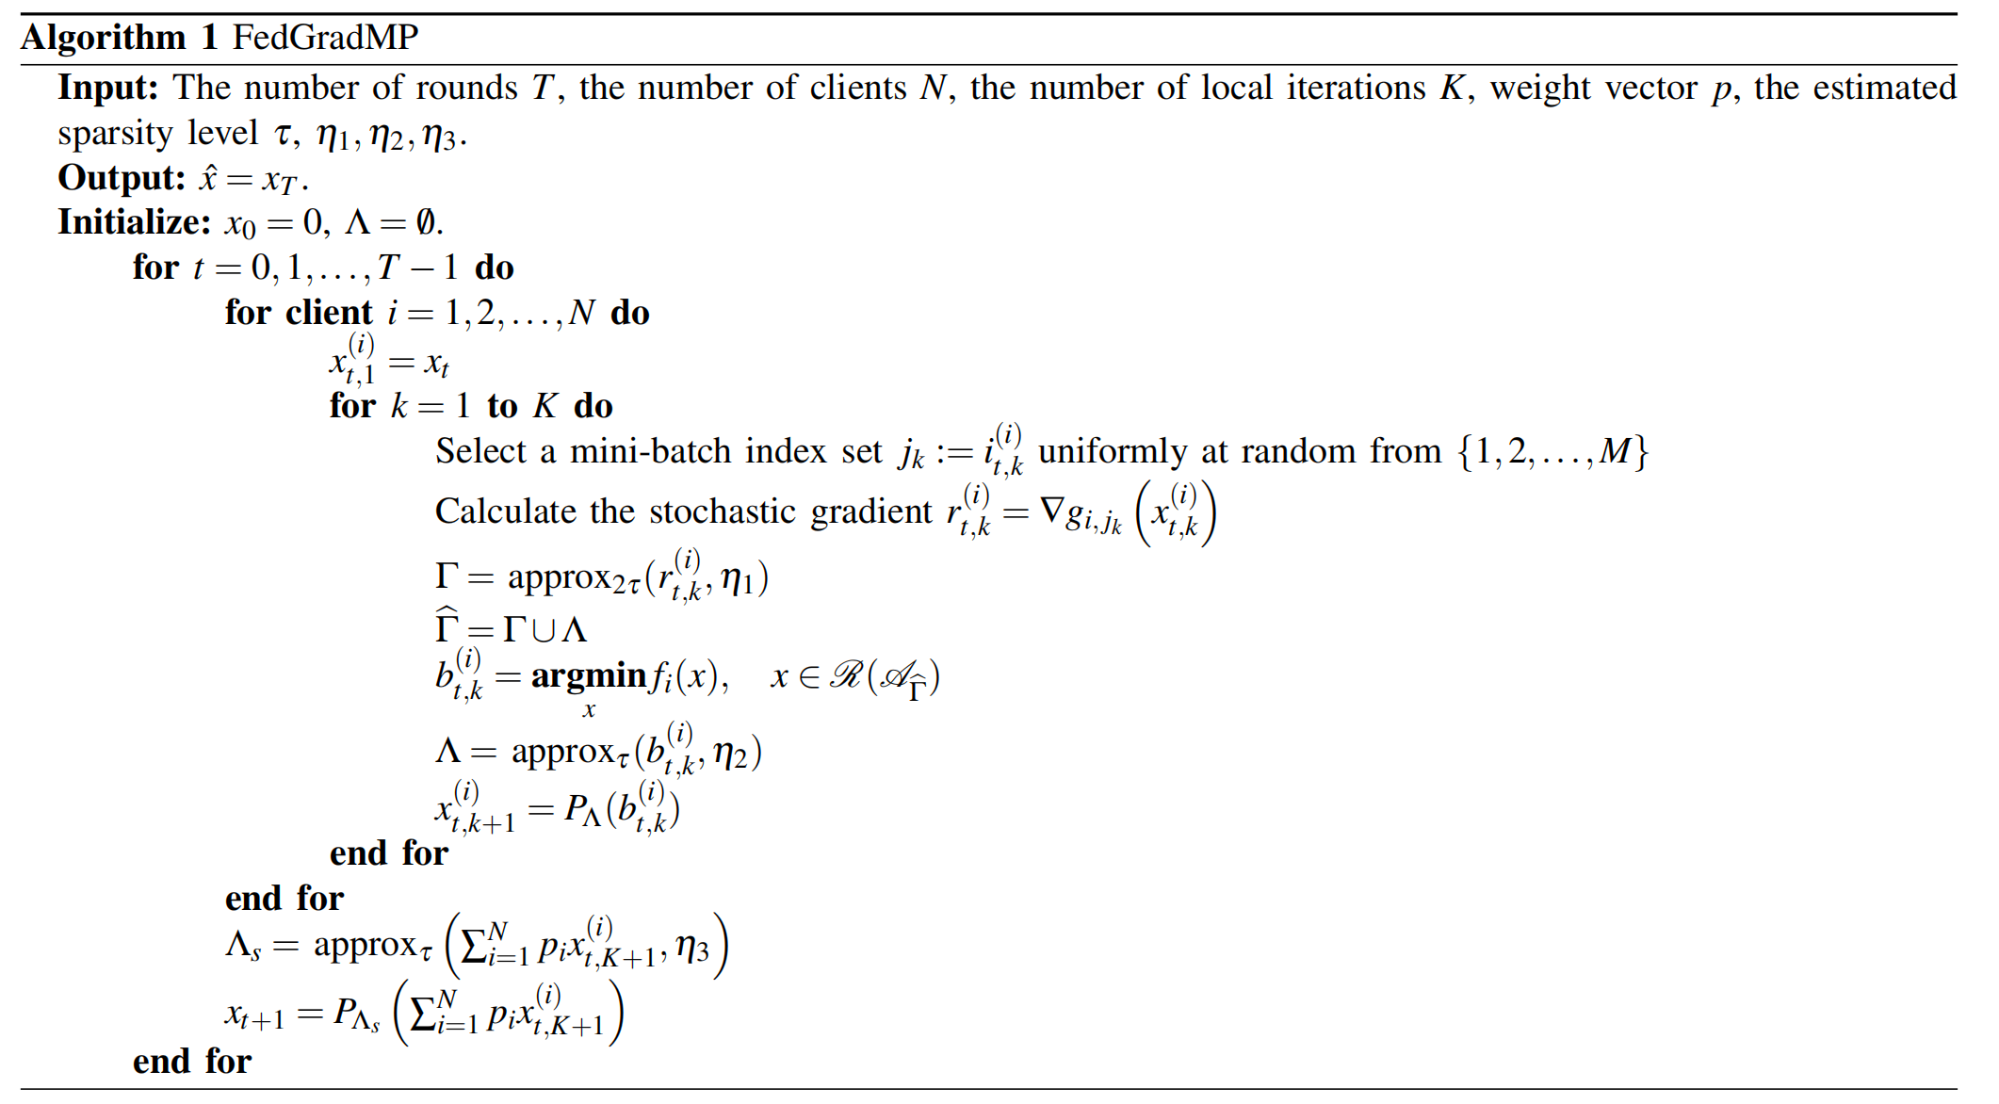
Method Design
CPS Computational Learning Laboratory

Slide 54
01
Problem Description
02
Method Design
03
Experiment Results
Contents
04
Conclusion
CPS Computational Learning Laboratory

Slide 55
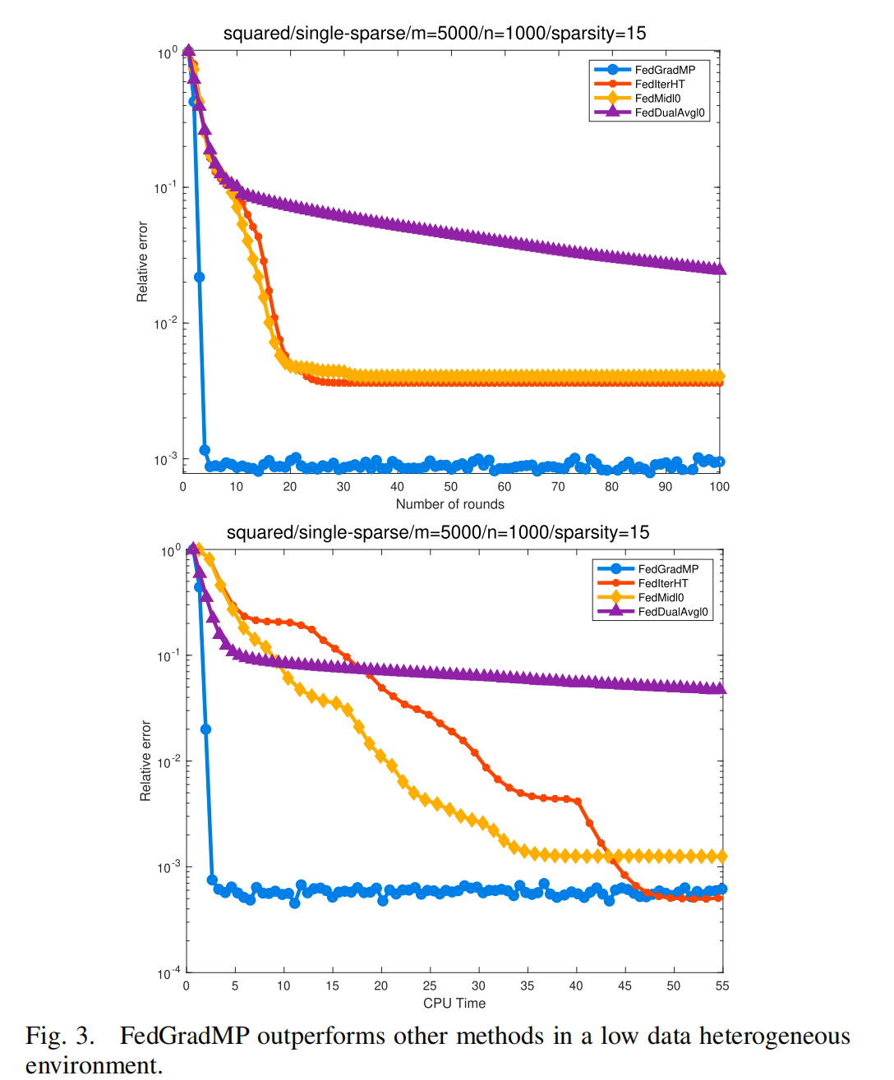
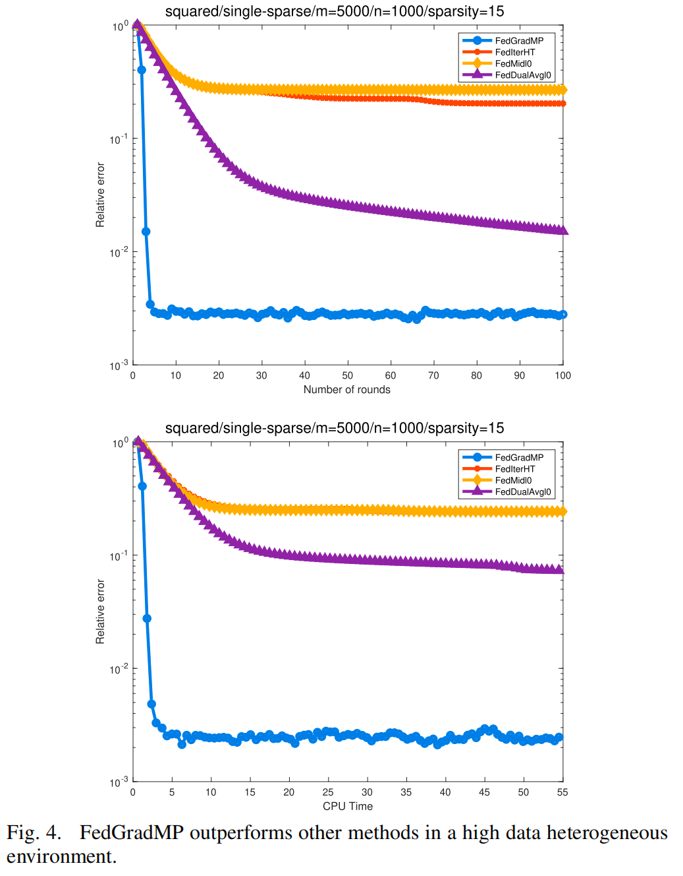
Experiment Results
CPS Computational Learning Laboratory

Slide 56
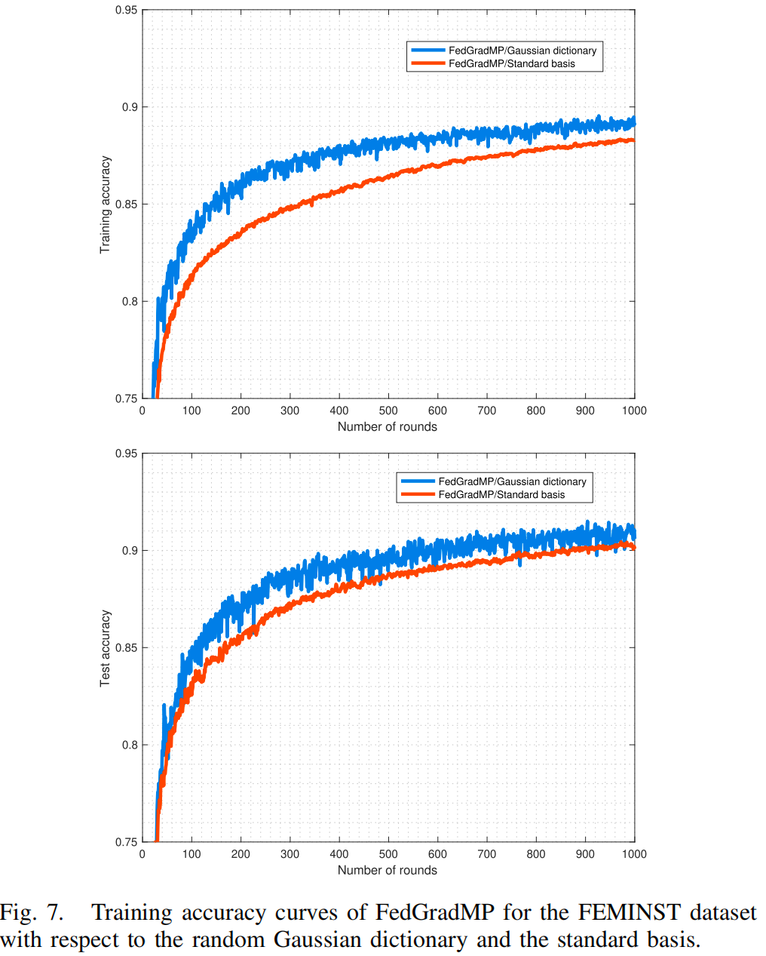
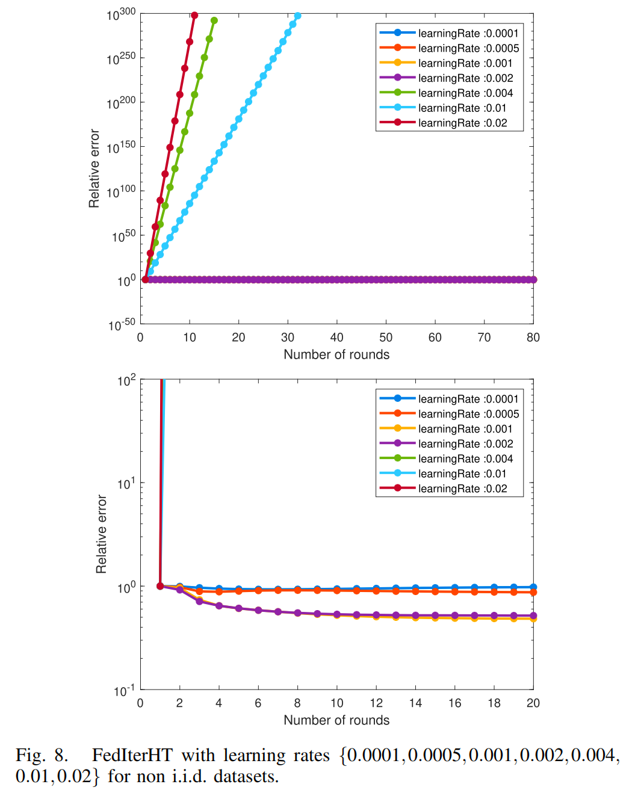
Experiment Results
CPS Computational Learning Laboratory

Slide 57
01
Problem Description
02
Method Design
03
Experiment Results
Contents
04
Conclusion
CPS Computational Learning Laboratory
CPS Computational Learning Laboratory
2
18

Slide 58
Conclusion
In this paper, we propose a novel federated stochastic gradient matching pursuit algorithm framework and show the linear convergence in expectation under certain assumptions of the objective function, including the dictionary restricted RSS/RSC conditions and the bounded heterogeneity only at optima assumption.
For the sparse linear regression problem, our method does not require learning rate tuning at the client side, which could be challenging for existing baseline algorithms in highly heterogeneous data environments.
Numerical experiments on large scale heterogeneous datasets such as EFMINIST and videos have shown the effectiveness of the proposed approach over the state-of-the-art federated learning algorithms.
Our analysis reveals the benefits of adopting random dictionaries such as Gaussian random dictionary, which is also confirmed by our numerical experiments.
Enlightenment：The multi-element with the largest gradient magnitude is retained by the approximate projection operation, which results in a locally optimal solution of the optimization objective function
CPS Computational Learning Laboratory

Slide 59
Paper 4
Layer-wised Model Aggregation for Personalized Federated Learning
Xiaosong Ma, Jie Zhang, Song Guo, and Wenchao Xu
Published in: IEEE/CVF Conference on Computer Vision and Pattern Recognition (CVPR)
Published Time: 2022
CPS Computational Learning Laboratory

Slide 60
01
Problem Description
02
Method Design
03
Experiment Results
Contents
04
Conclusion
CPS Computational Learning Laboratory

Slide 61
01
Problem Description
02
Method Design
03
Experiment Results
Contents
04
Conclusion
CPS Computational Learning Laboratory

Slide 62
Problem Description
We propose a novel pFL training framework dubbed Layer-wised Personalized Federated learning (pFedLA) that can discern the importance of each layer from different clients, and thus is able to optimize the personalized model aggregation for clients with heterogeneous data.
Specifically, we employ a dedicated hypernetwork per client on the server side, which is trained to identify the mutual contribution factors at layer granularity.
Meanwhile, a parameterized mechanism is introduced to update the layer-wised aggregation weights to progressively exploit the inter-user similarity and realize accurate model personalization.
CPS Computational Learning Laboratory

Slide 63
01
Problem Description
02
Method Design
03
Experiment Results
Contents
04
Conclusion
CPS Computational Learning Laboratory

Slide 64
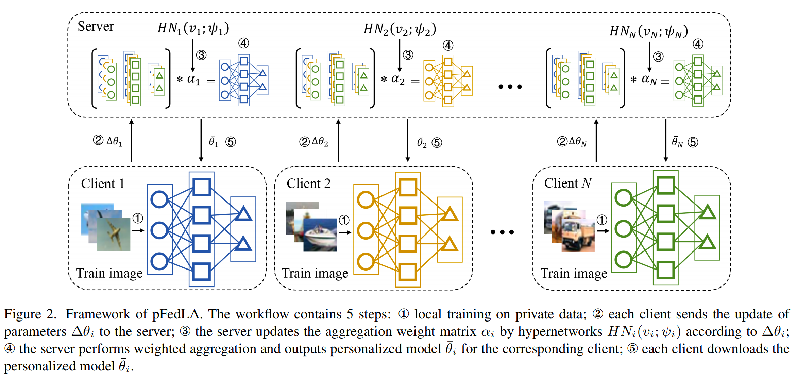
Method Design
CPS Computational Learning Laboratory

Slide 65
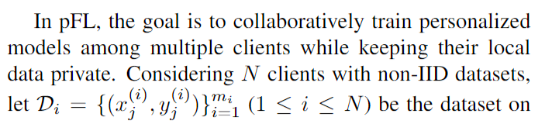
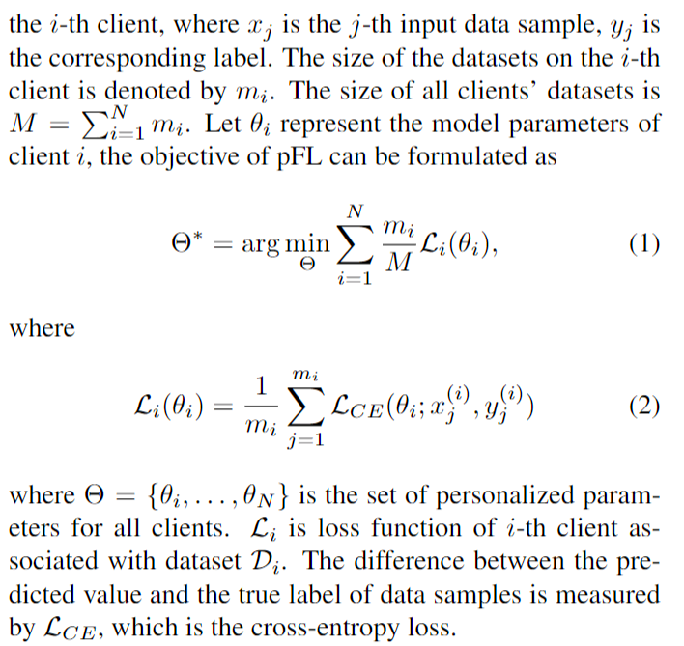
Method Design
PFL problem formulation
CPS Computational Learning Laboratory

Slide 66

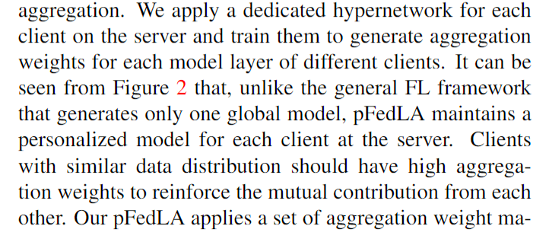
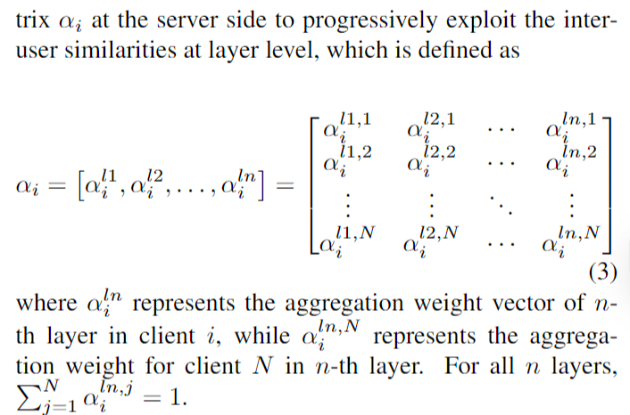
Method Design
How to valuate the importance of each layer from different clients to achieve layer-wised personalized model aggregation?
CPS Computational Learning Laboratory

Slide 67
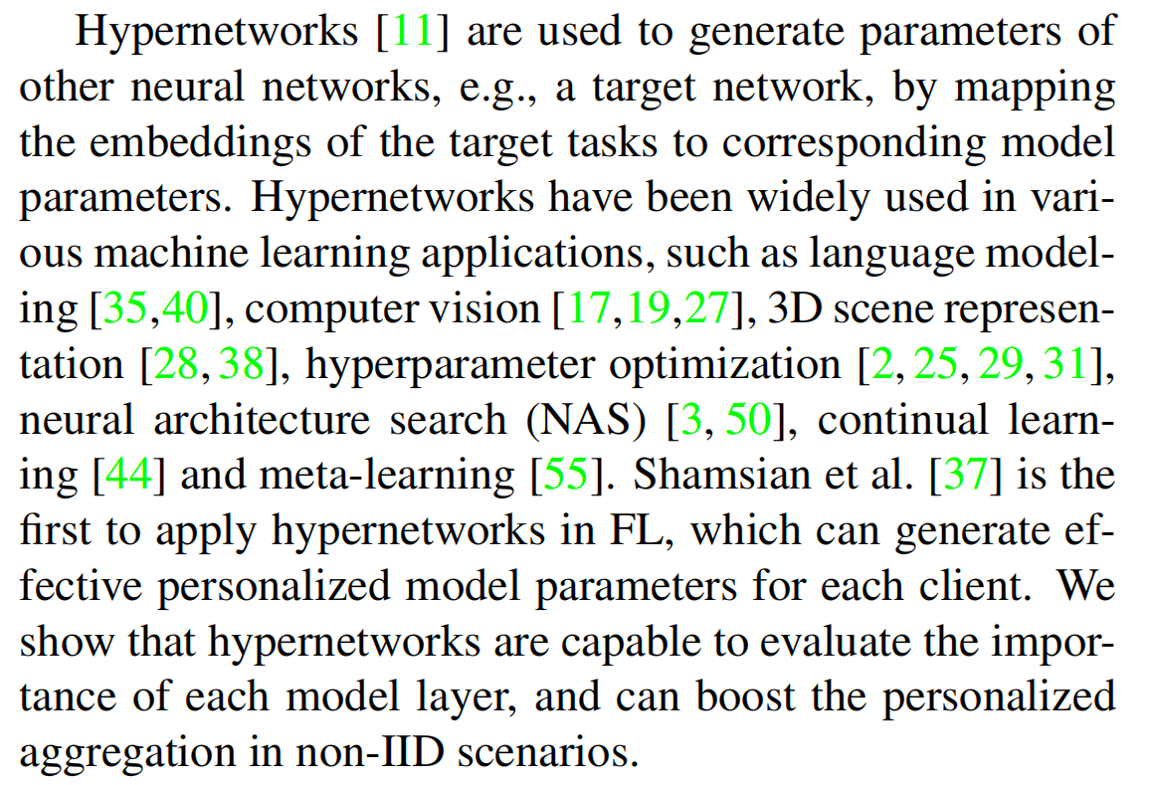
Method Design
Hypernetworks
CPS Computational Learning Laboratory

Slide 68
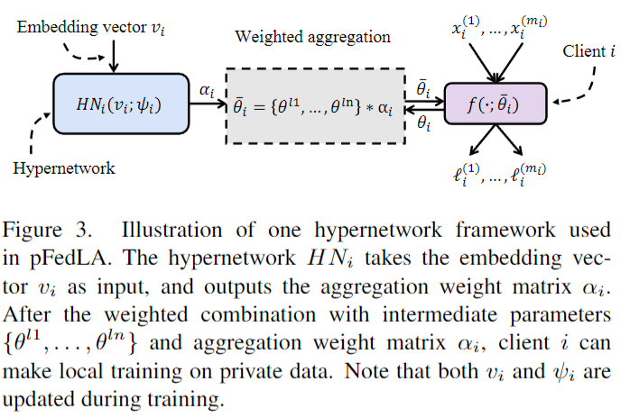
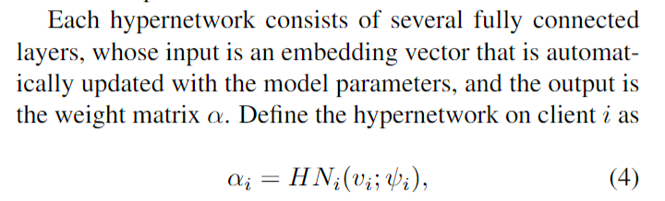
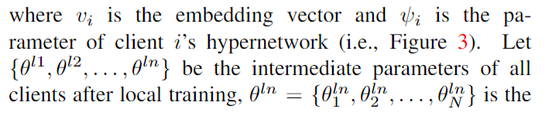
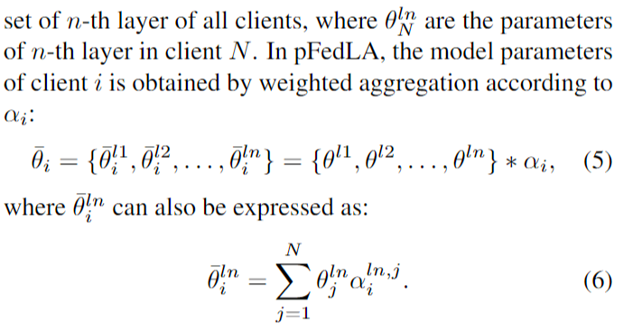
Method Design
How hypernetwork works
CPS Computational Learning Laboratory

Slide 69
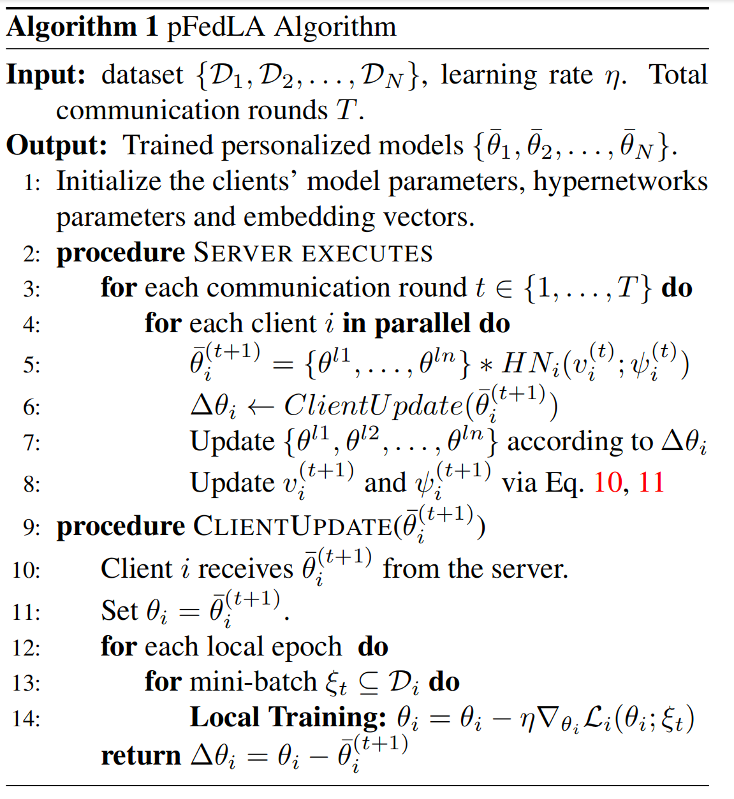
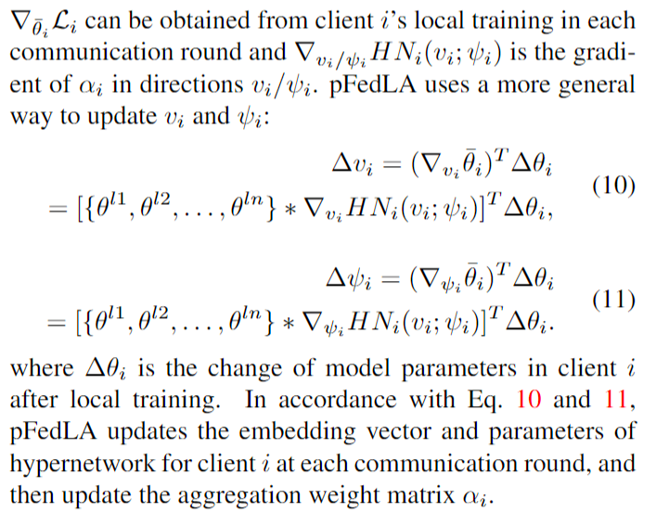
Method Design
CPS Computational Learning Laboratory

Slide 70
01
Problem Description
02
Method Design
03
Experiment Results
Contents
04
Conclusion
CPS Computational Learning Laboratory

Slide 71
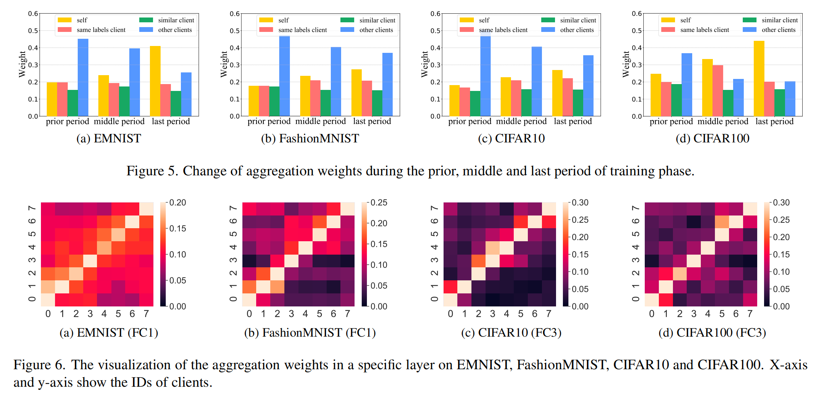
Method Design
CPS Computational Learning Laboratory

Slide 72
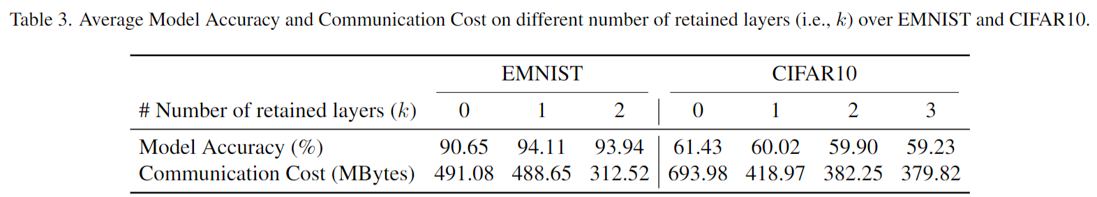
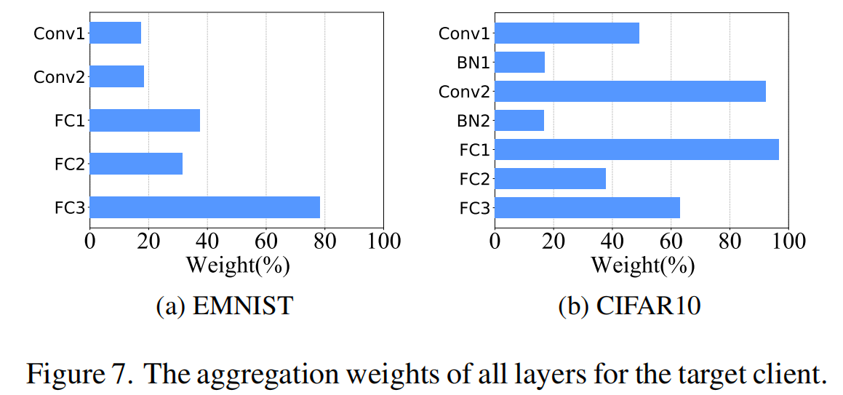
Experiment Results
CPS Computational Learning Laboratory

Slide 73
01
Problem Description
02
Method Design
03
Experiment Results
Contents
04
Conclusion
CPS Computational Learning Laboratory
CPS Computational Learning Laboratory
2
18

Slide 74
Conclusion
In this paper, we have proposed a novel pFL training framework called pFedLA, to achieve personalized model aggregation in a layer-wised aggregation manner.
It is shown that such layer-wised aggregation can progressively reinforce the collaboration among similar clients and generate adequate personalization over non-IID datasets that outperform conventional model-wised approaches.
Enlightenment：Better aggregation can be achieved by generating different parameters for each layer of the model through the hypernetwork
CPS Computational Learning Laboratory

Slide 75
Paper 5
TOWARDS LAYER-WISE PERSONALIZED FEDERATED LEARNING:ADAPTIVE LAYER DISENTANGLEMENT VIA CONFLICTING GRADIENTS
Minh Duong Nguyen, Khanh Le, Khoi Do, Nguyen H.Tran, Duc Nguyen, Chien Trinh, Zhaohui Yang
Publish Journal: Arxiv
Published Time: 2024
CPS Computational Learning Laboratory

Slide 76
01
Problem Description
02
Method Design
03
Experiment Results
Contents
04
Conclusion
CPS Computational Learning Laboratory

Slide 77
01
Problem Description
02
Method Design
03
Experiment Results
Contents
04
Conclusion
CPS Computational Learning Laboratory

Slide 78
Problem Description
In personalized Federated Learning (pFL), high data heterogeneity can cause significant gradient divergence across devices, adversely affecting the learning process. This divergence, especially when gradients from different users form an obtuse angle during aggregation, can negate progress, leading to severe weight and gradient update degradation
Specifically, when layer-wise gradients of different clients form acute angles, those gradients align in the same direction, enabling updates across different clients toward identifying client-invariant features.
Conversely, when layer-wise gradient pairs make create obtuse angles, the layers tend to focus on client-specific tasks. In hindsights, FedLAG assigns layers for personalization based on the extent of layer-wise gradient conflicts. Specifically, layers with gradient conflicts are excluded from the global aggregation process.
CPS Computational Learning Laboratory

Slide 79
01
Problem Description
02
Method Design
03
Experiment Results
Contents
04
Conclusion
CPS Computational Learning Laboratory

Slide 80

Method Design
Figure 1: The issue of gradient conflicts, we denote ideal gradient as the aggregated gradient when component gradients do not make any conflicts, i.e., when the conflicted gradient with angle morethan π/2 is projected into π/2.
CPS Computational Learning Laboratory

Slide 81

Method Design
CPS Computational Learning Laboratory

Slide 82

Method Design
Is gradient conflicts appear among users in federated learning?
CPS Computational Learning Laboratory

Slide 83


Method Design
CPS Computational Learning Laboratory

Slide 84

Method Design
CPS Computational Learning Laboratory

Slide 85

Method Design
CPS Computational Learning Laboratory

Slide 86

Method Design
Maintain the global aggregation of FL on non-conflict layers
Motivate the personalized learning on conflict layers
CPS Computational Learning Laboratory

Slide 87

Method Design
CPS Computational Learning Laboratory

Slide 88



Method Design
CPS Computational Learning Laboratory

Slide 89

Method Design
CPS Computational Learning Laboratory

Slide 90


Method Design
CPS Computational Learning Laboratory

Slide 91



Method Design
CPS Computational Learning Laboratory

Slide 92


Method Design
PROOF ON LEMMA 5.1
CPS Computational Learning Laboratory

Slide 93

Method Design
CPS Computational Learning Laboratory

Slide 94


Method Design
CPS Computational Learning Laboratory

Slide 95



Method Design
CPS Computational Learning Laboratory

Slide 96

Method Design
Proof on Theorem 5.3
CPS Computational Learning Laboratory

Slide 97

Method Design
CPS Computational Learning Laboratory

Slide 98

Method Design
Derivation of Q1：
CPS Computational Learning Laboratory

Slide 99

Method Design
CPS Computational Learning Laboratory

Slide 100

Method Design
CPS Computational Learning Laboratory

Slide 101

Method Design
Derivation of Q2：
CPS Computational Learning Laboratory

Slide 102

Method Design
Derivation of Q2：
CPS Computational Learning Laboratory

Slide 103

Method Design
Derivation of Q3：
CPS Computational Learning Laboratory

Slide 104

Method Design
Derivation of Q4：
CPS Computational Learning Laboratory

Slide 105

Method Design
Combining equation 48, equation 54, equation 55, equation 56 together, we have:
：
CPS Computational Learning Laboratory

Slide 106

Method Design
：
CPS Computational Learning Laboratory

Slide 107

Method Design
：
CPS Computational Learning Laboratory

Slide 108

Method Design
：
CPS Computational Learning Laboratory

Slide 109

Method Design
：
CPS Computational Learning Laboratory

Slide 110


Method Design
：
CPS Computational Learning Laboratory

Slide 111


Method Design
：
CPS Computational Learning Laboratory

Slide 112
01
Problem Description
02
Method Design
03
Experiment Results
Contents
04
Conclusion
CPS Computational Learning Laboratory

Slide 113

Experiment Results
CPS Computational Learning Laboratory

Slide 114

Experiment Results
CPS Computational Learning Laboratory

Slide 115
01
Problem Description
02
Method Design
03
Experiment Results
Contents
04
Conclusion
CPS Computational Learning Laboratory
CPS Computational Learning Laboratory
2
18

Slide 116
Conclusion
Layer-Wised Aggregation :
Unlike conventional pFL methods that aggregate entire models, pFedLA performs aggregation at the layer level. This approach considers the differing importance of neural network layers (e.g., shallow layers focus on local feature extraction, while deeper layers focus on global features), enabling more accurate personalized model generation.
Hypernetworks for Weight Generation :
A dedicated hypernetwork is introduced for each client to dynamically generate layer-specific aggregation weights. These weights progressively exploit inter-user similarities and improve personalization over non-IID datasets.
Heuristic Improvement (HeurpFedLA) :
To reduce communication overhead, the authors propose HeurpFedLA , which retains certain local layers during training and avoids aggregating them. This reduces communication costs with minimal impact on model performance.
Enlightenment：The detailed derivation of the formulas improved my understanding of the formulas
CPS Computational Learning Laboratory

Slide 117
Inspiration
Federated learning is inextricably linked to gradients, which add noise to protect privacy, adjustments to gradients to fit old tasks, and weights computed on layer-wise gradients for better aggregation, and the gradient approach can bring more benefits to federated learning in all aspects of its application.
In subsequent research, I will consider applying the noise formulas and layer-wise gradient weight calculation methods from these papers to my first paper.
CPS Computational Learning Laboratory

Slide 118
Thank you for listening

